Slide 1
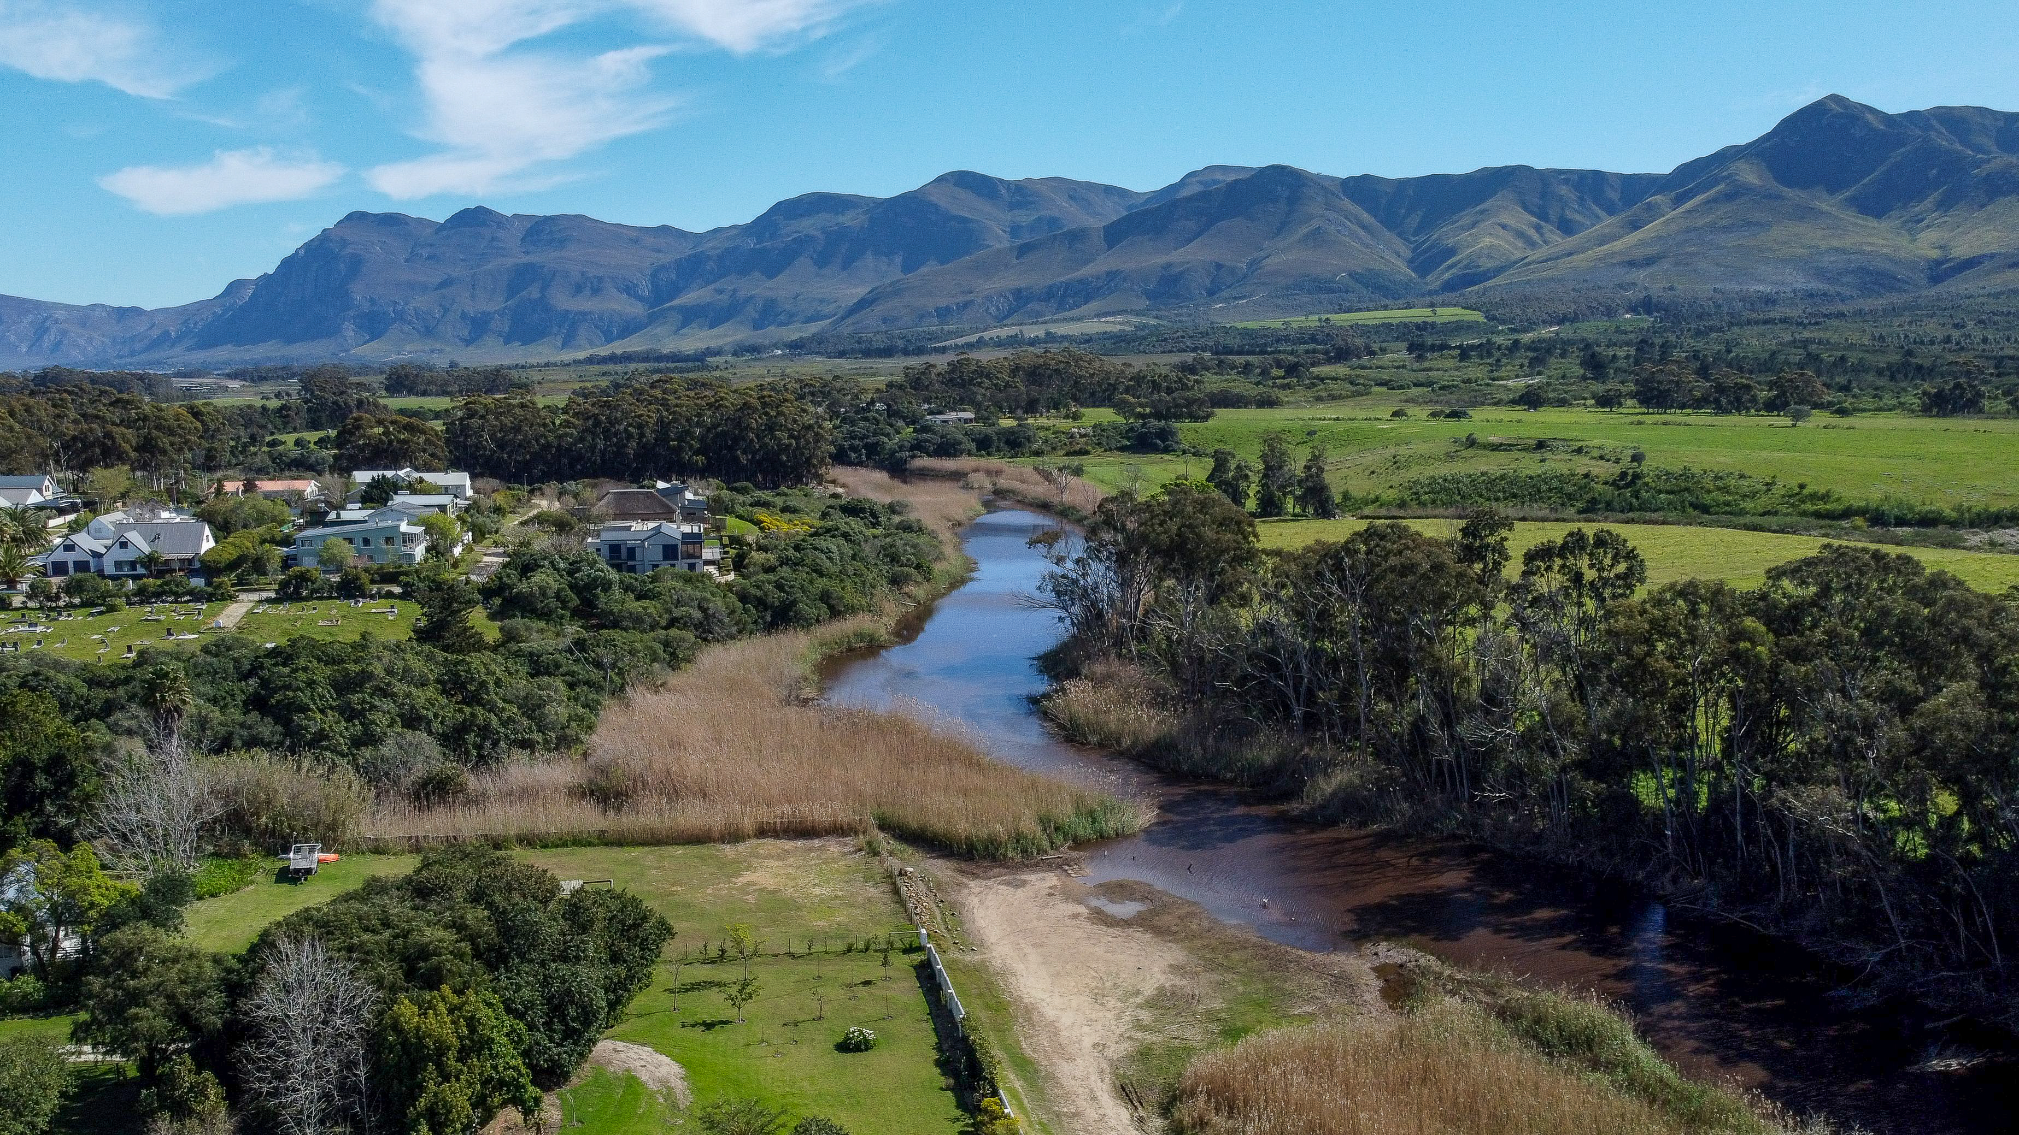
Stanford Conservation Trust
ANNUAL GENERAL MEETING – 16 MAY 2024

Slide 2
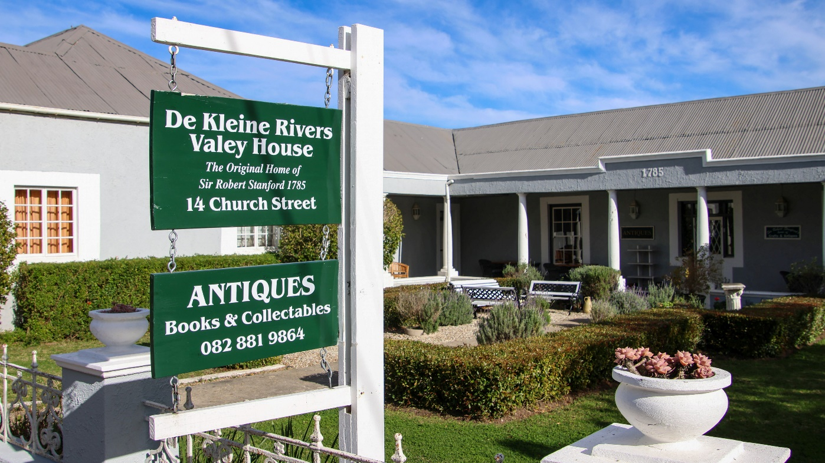
Stanford Conservation
INTRODUCTION
In summary, the purpose of Stanford Conservation is to protect and conserve the environment (in all forms), and heritage (architectural & natural resources) in the urban and rural areas of Stanford managed by the Stanford Administration of the Overstrand Municipality.

Slide 3
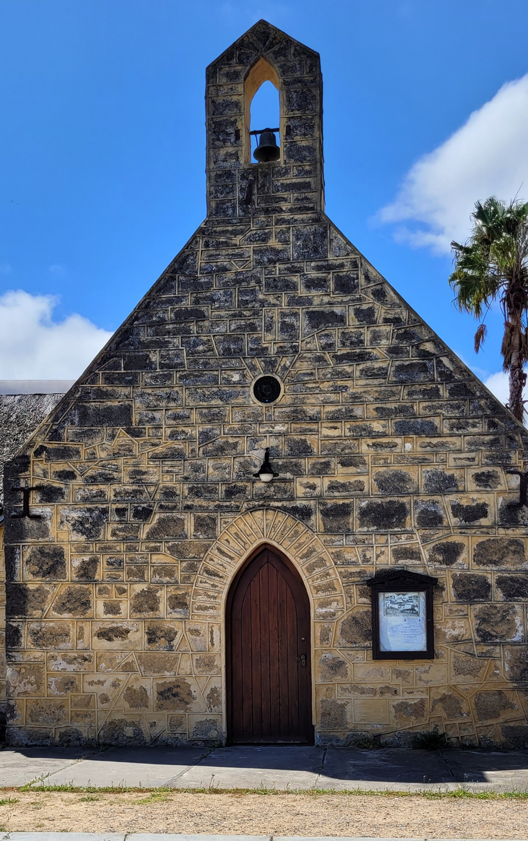
Stanford Conservation
GENERAL INFORMATION
Established in 1992.
Registered as an NPO 024-867 & a PBO Ref No 930079535.
Exempt from Income Tax for donations received.
Depending on the activities of the organisation, donors are provided with a tax-deductible Section 18A receipt (still “in process” for approval).
Bound to its Constitution as amended April ’24 by the directors/management committee. Vote!
Audited financials in compliance with the NPO Act of SA.

Slide 4
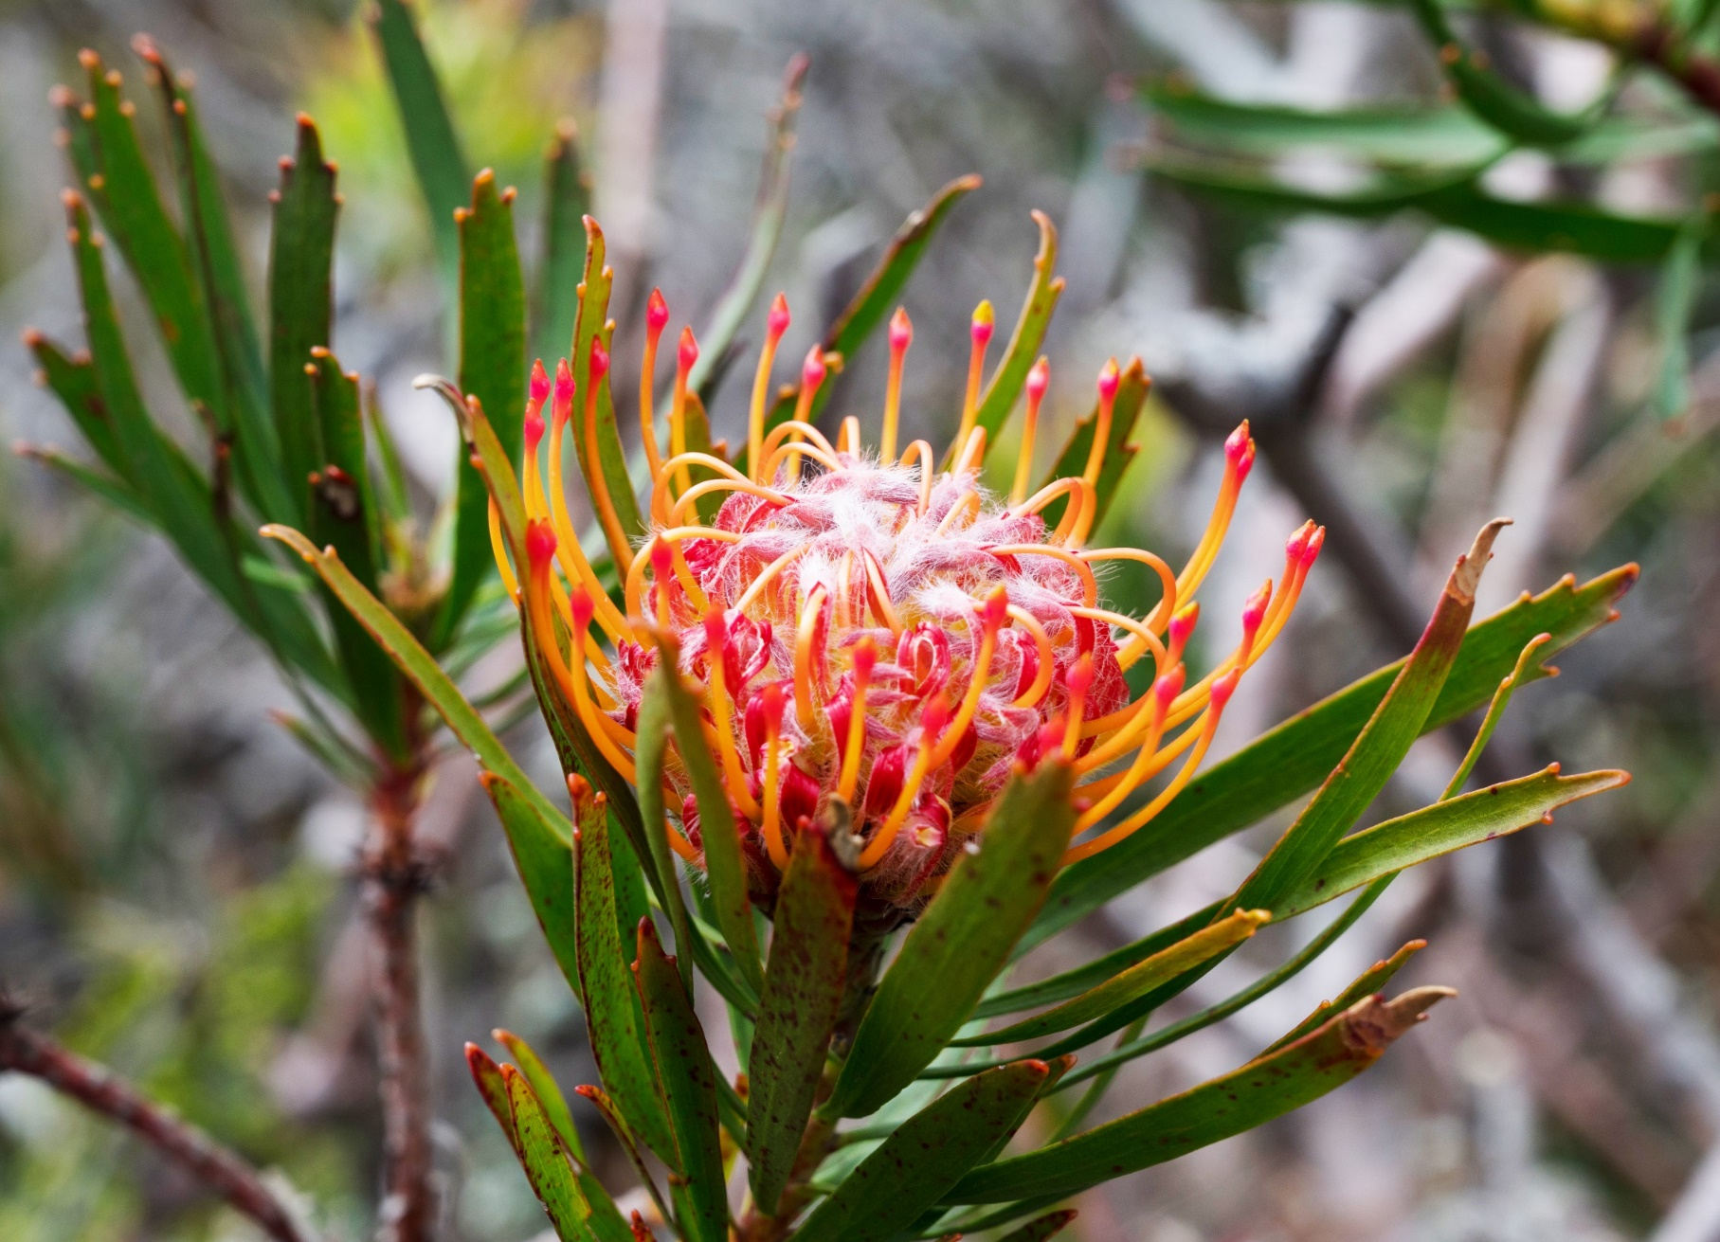
Stanford Conservation
MANAGEMENT COMMITTEE
MEMBERS
John Kelley (Chairperson)
Bea Whittaker (Treasurer)
Melissa Mc Alpine (Secretary)
James Aling (Heritage)
Dave Hagen (Wandelpad & Ward 1)
Linda Strydom (Swop Shop)
Debbie Braunlich (Forgotten Ones)
Keith Brown (St Thomas Church)
Individual commitment to a
group effort - that’s what makes
a team work!

Slide 5
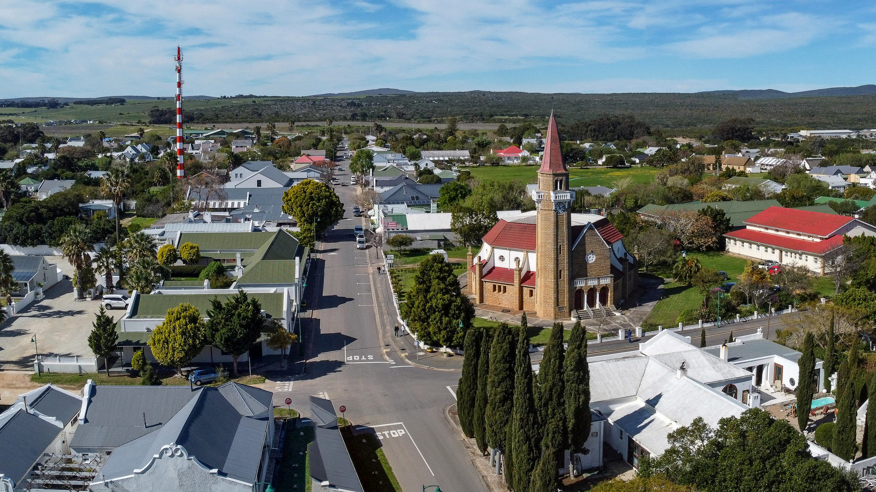
Chairperson’s Report
John Kelley

Slide 6
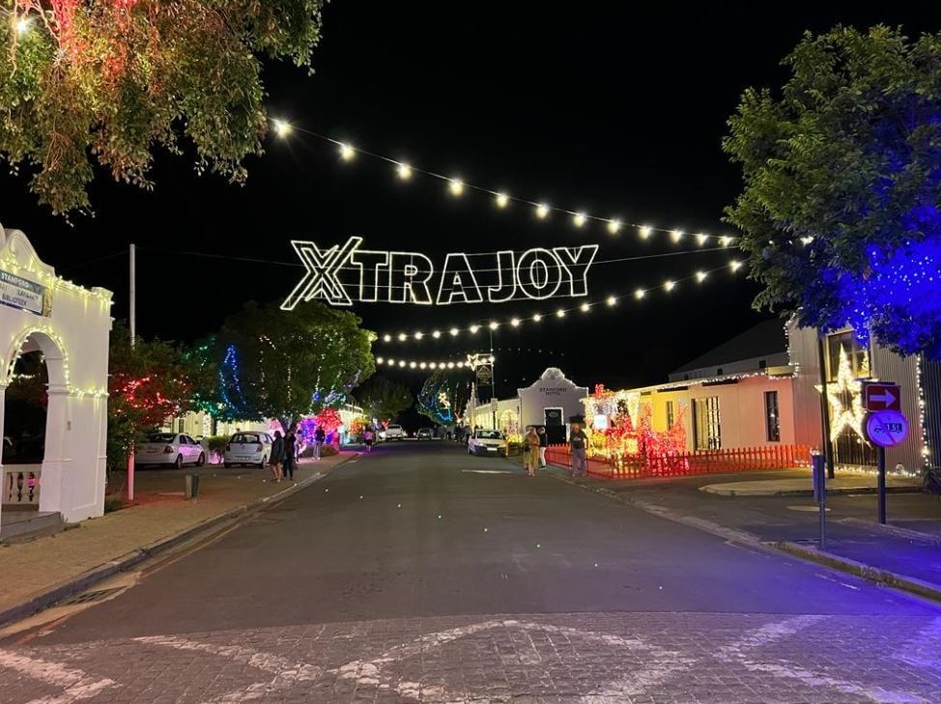
Chairperson’s Report
HIGHLIGHTS 2023/24
1.
ABSA Cape Epic Cycle Race
3.
5.
Forgotten Ones - Cemeteries
Ended FY on R35 vs R67k surplus
last year
2.
4.
6
St Thomas Church Restoration
Stanford Festive Lights
New Property Owners Information Guide

Slide 7
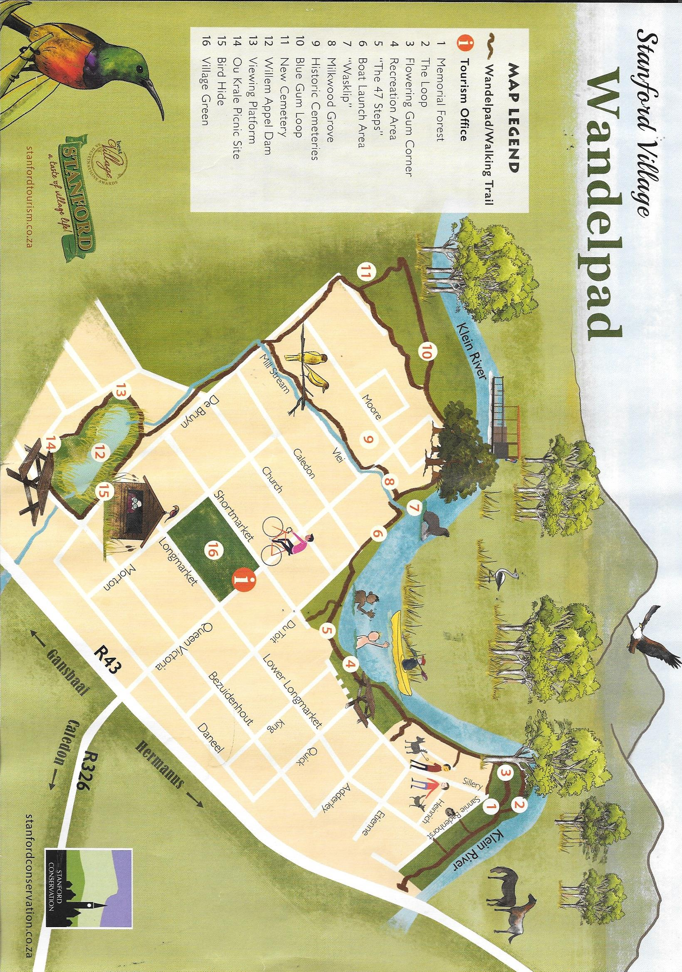
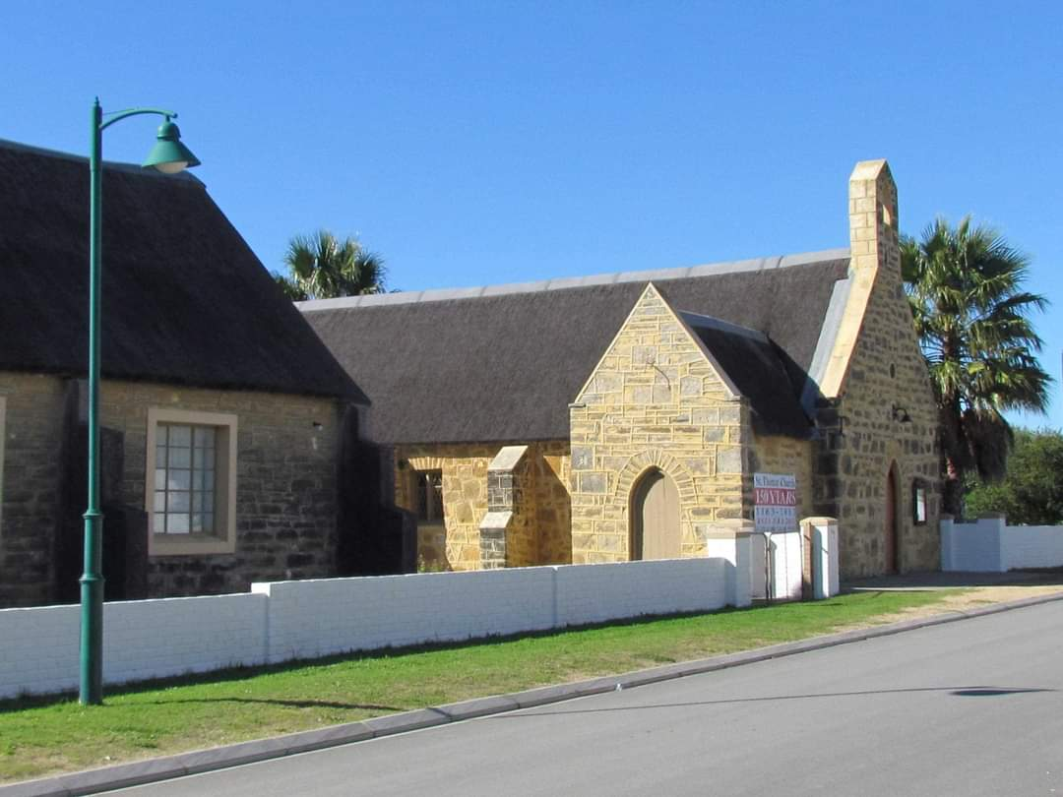
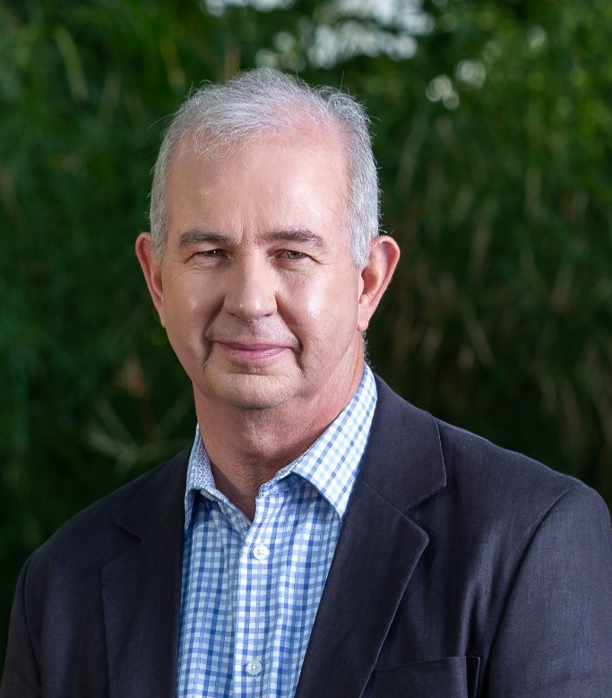
Chairperson’s Report
LOOKING FORWARD TO 2024/25
1.
3.
5.
Re-Establishment of Chairs Forum
St Thomas Church
New Heritage Committee Chair
- James Aling
2.
4.
New Website (Project)
Wandelpad Map & Signage
Stanford Municipality
Charl Cornelius
(Principle Administrative Officer)
Cameron “Cammy” Damon
(Cammy’s Team of Muni Workers)
Ward 1
Councilor Dudley Coetzee
Once-off Reed Cutting Funds
IDP Items for Stanford Conservation

Slide 8
Chairperson’s Report
SPECIAL THANKS!
Martin Ranger (Amended Constitution)
Leigh King (Think & Drink Quiz Night)
Kevin King (Reed Project)
Katie Smuts (Annalize Mouton Reference Library)
Management Committee
All Stanford Conservation Volunteers

Slide 9
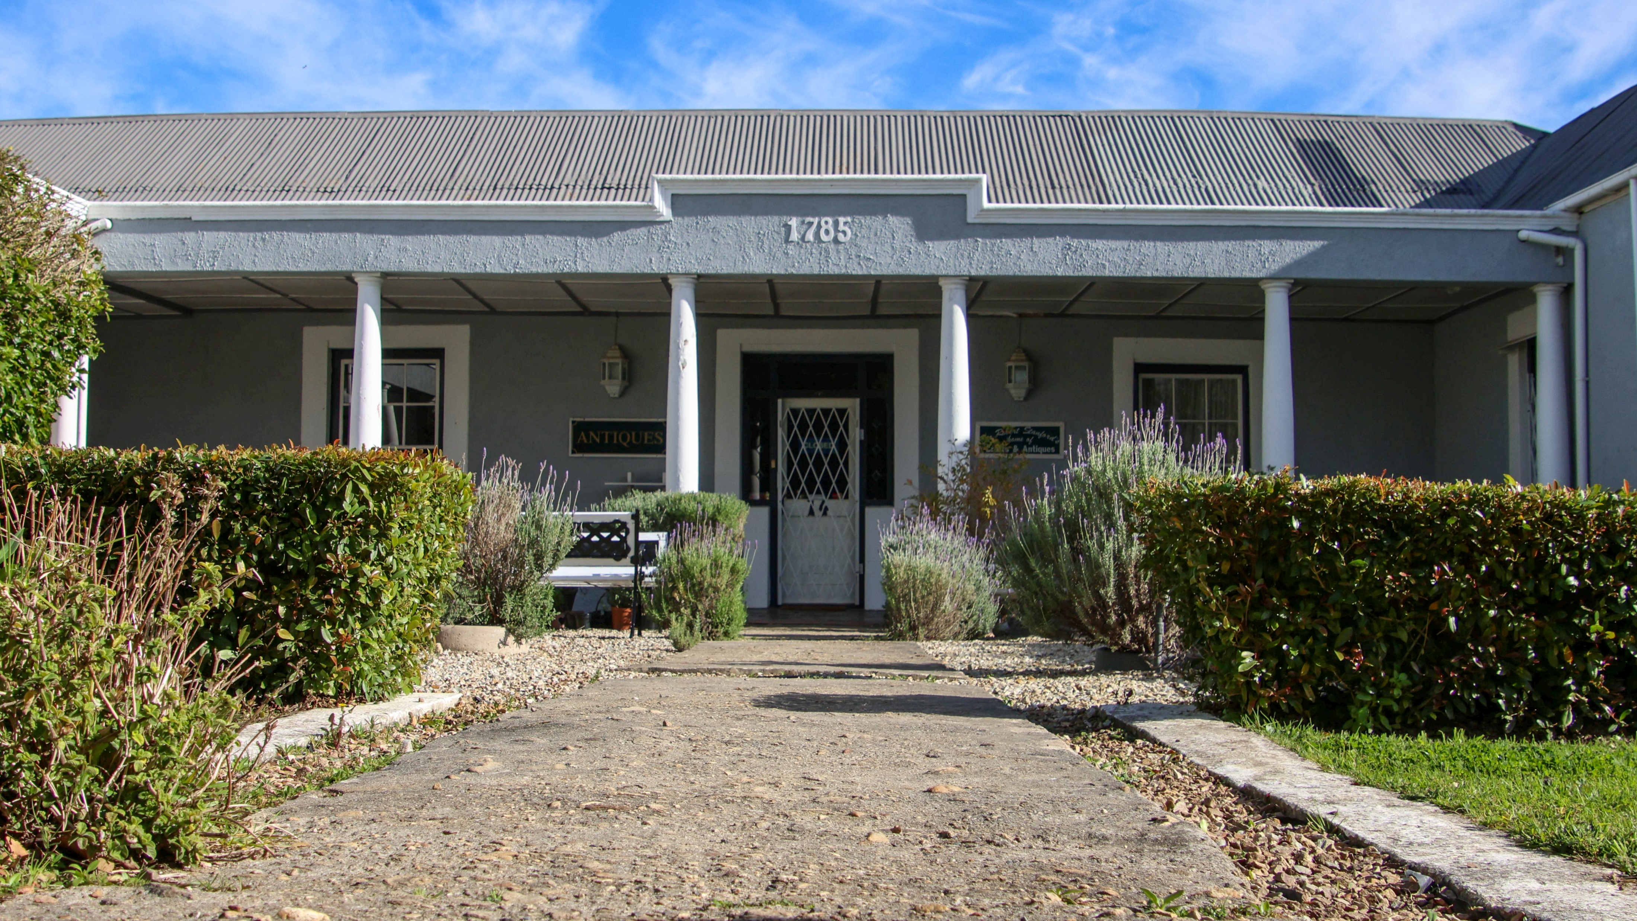
Heritage Committee Report
John Kelley

Slide 10
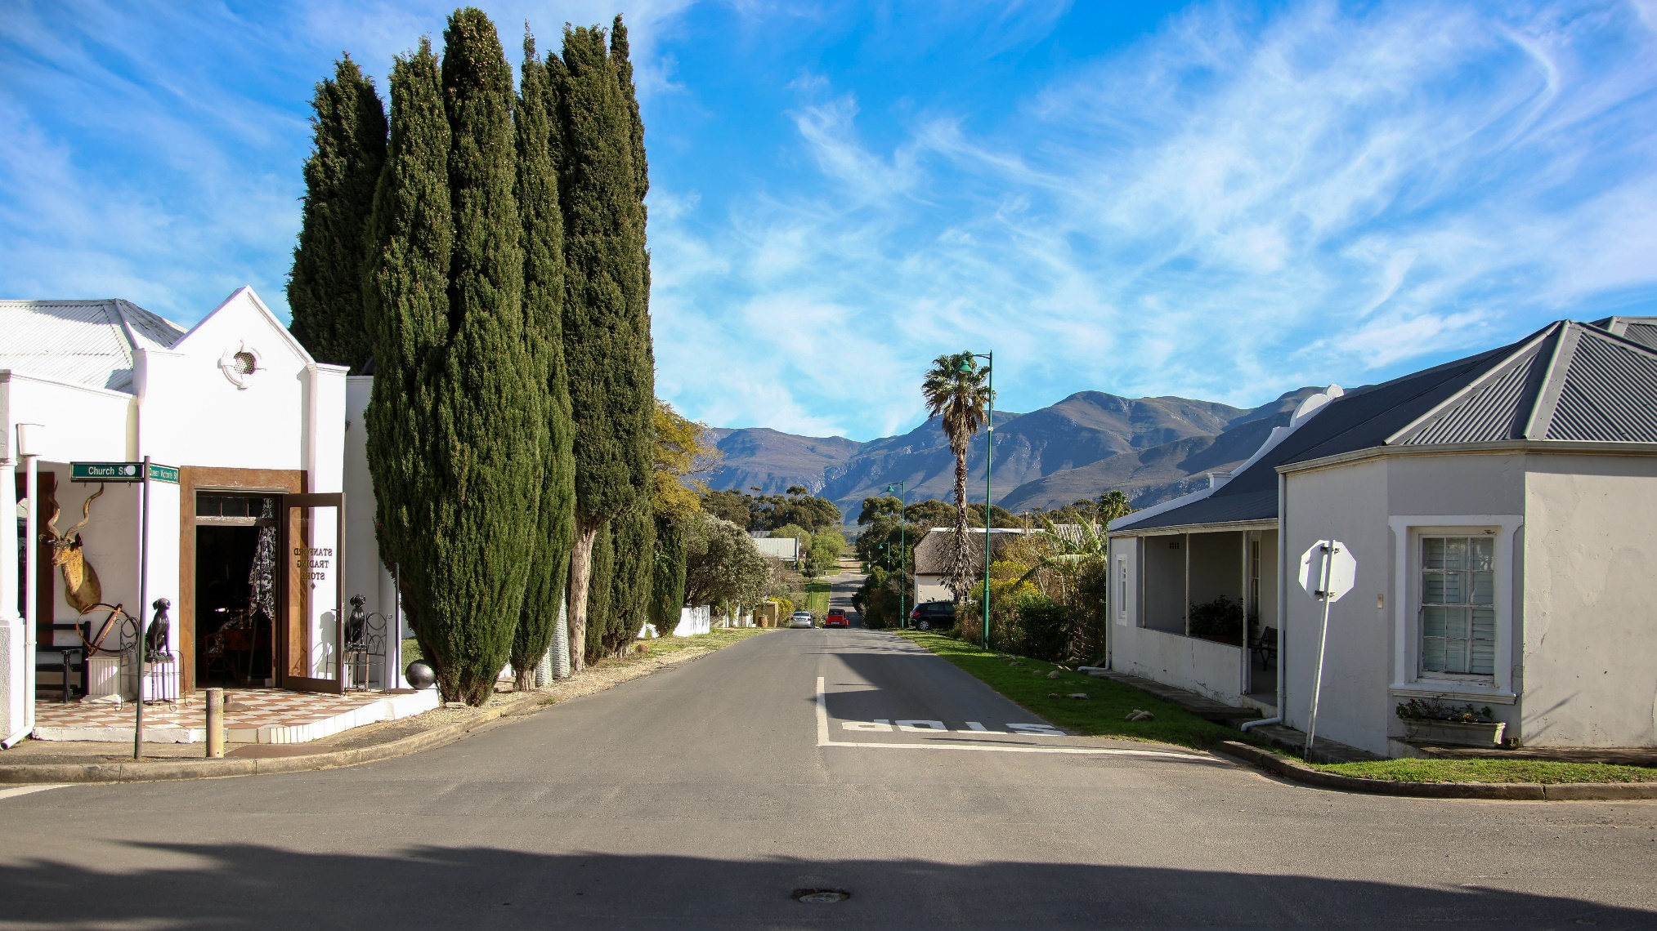
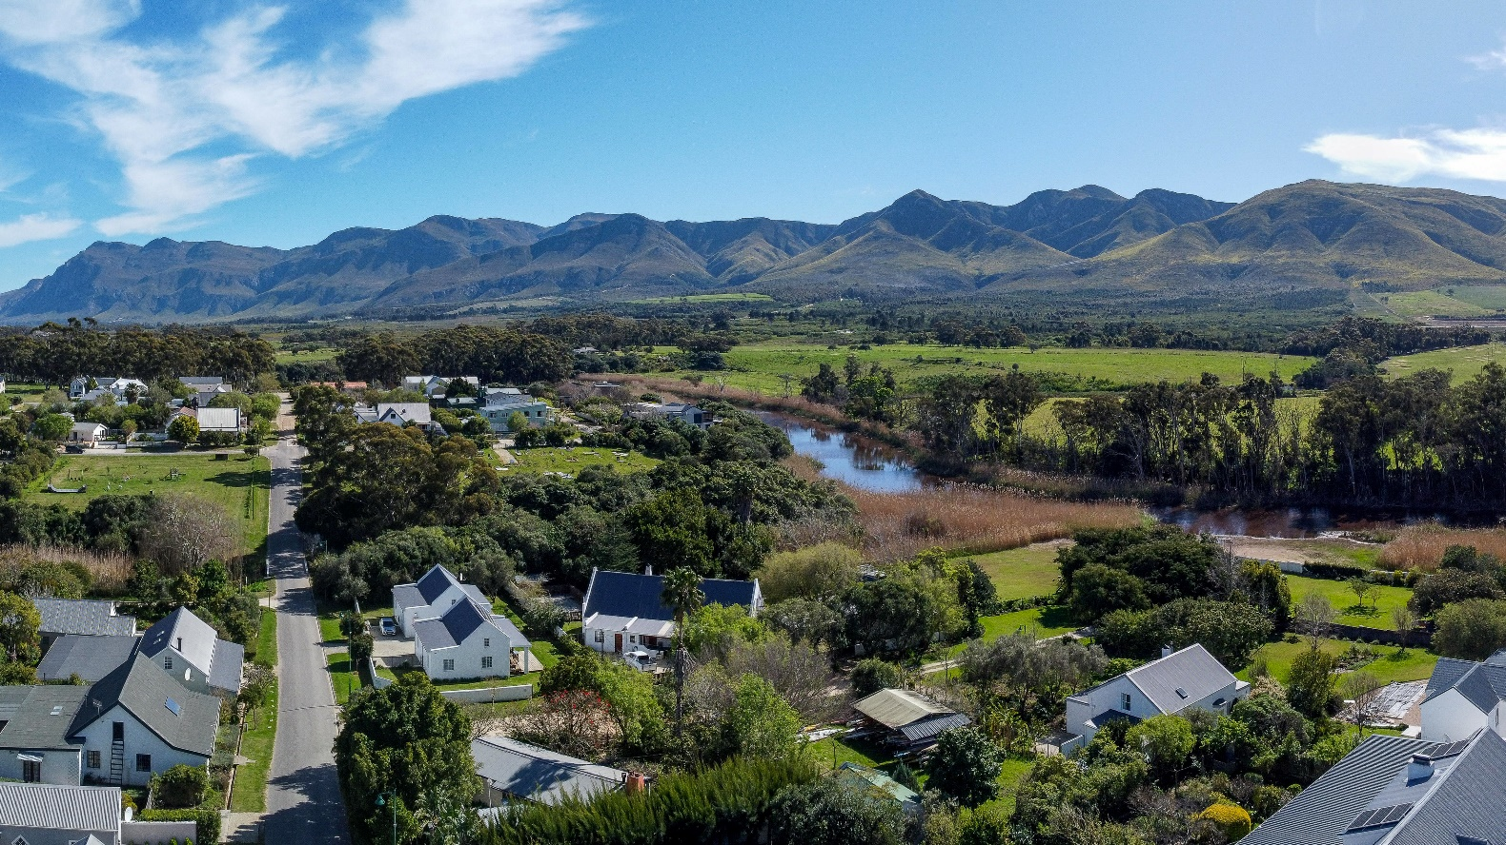
Heritage Committee
COMMITTEE MEMBERS
James Aling (New Chairperson)
Gregg Goddard
Jan Biernacki
Maureen Wolters
Marian Ferris
Keith Brown
Colette Van Niftrik

Slide 11
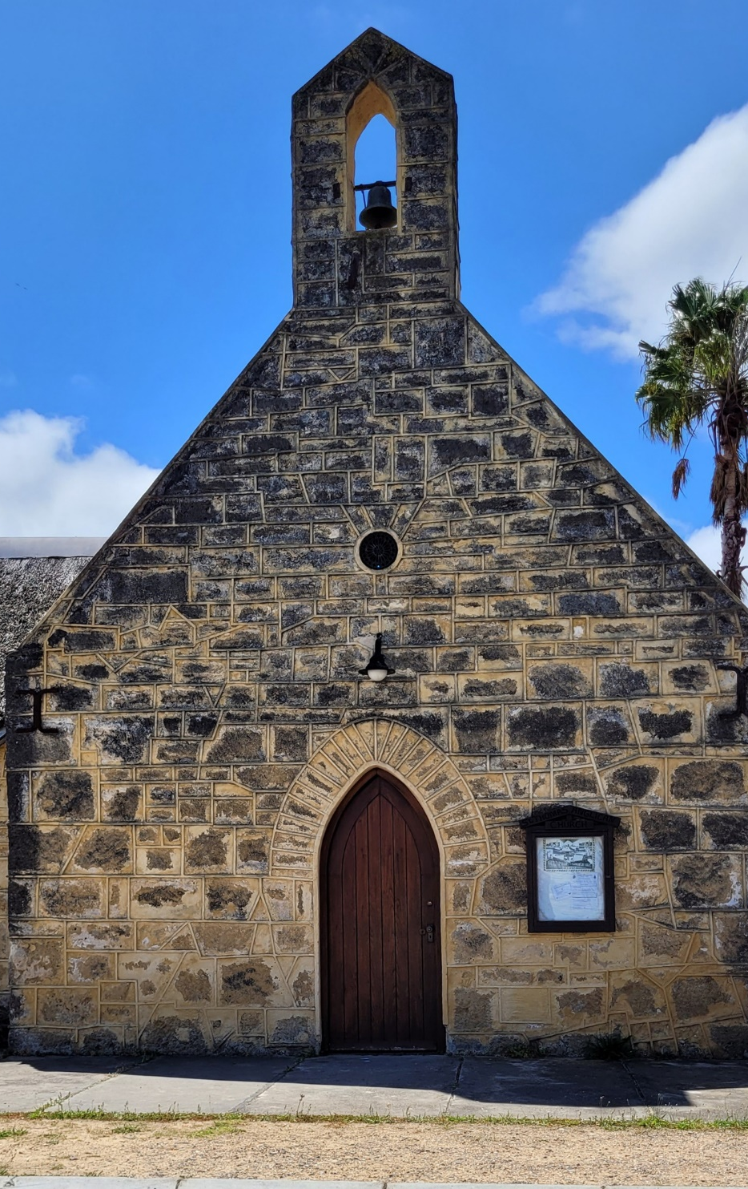
Heritage Committee
REASONS WHY STANFORD HAS A
HERITAGE COMMITTEE…
To preserve and maintain Stanford’s historical features and architectural heritage.
Stanford was proclaimed a conservation area in 1995 in terms of the then National Monuments Act.
National Heritage Resources Act, Act No. 25 of 1999 (NHRA), and the conservation area was proclaimed a Heritage Area in terms of Section 28 of the Act.
Registered with Heritage Western Cape (HWC) (HM/CB/0815/30)
Overstrand Municipality (OM), has a duty to protect the Stanford Heritage Area, in part by means of a Stanford Heritage Protection Overlay Zone.
SHC is a “commentary body” that serves a local representation to HWC

Slide 12
Heritage Committee
LOOKING BACK…
SHC reviewed +/- 60 submissions (conceptual & detailed).
SHC provided comments as I&AP to departures, rezoning, consolidation of Erfs, etc.
SHC made itself available to meet with submitters in advance of application to help understand the process.
In an effort to reduce process time, “resubmissions” that require minimal “technical” changes to plans, is done via a round-robin email review that can shave weeks off the SHC process.

Slide 13
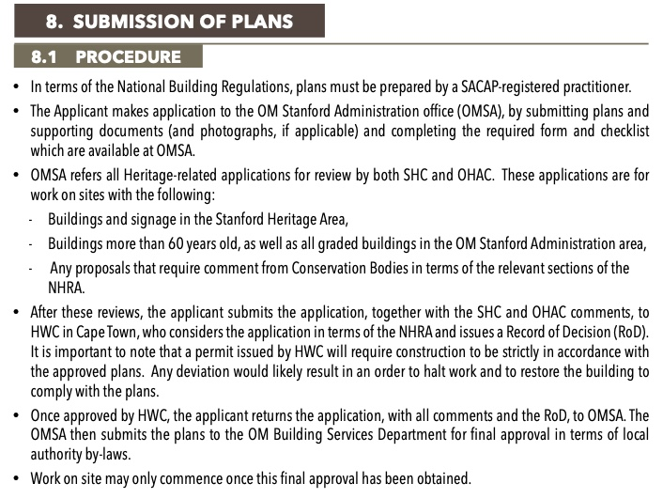
Heritage Committee
THE PROCESS AS OUTLINED IN THE
STANFORD STYLE GUIDE

Slide 14
Heritage - Leiwater
Lyn Pullen

Slide 15
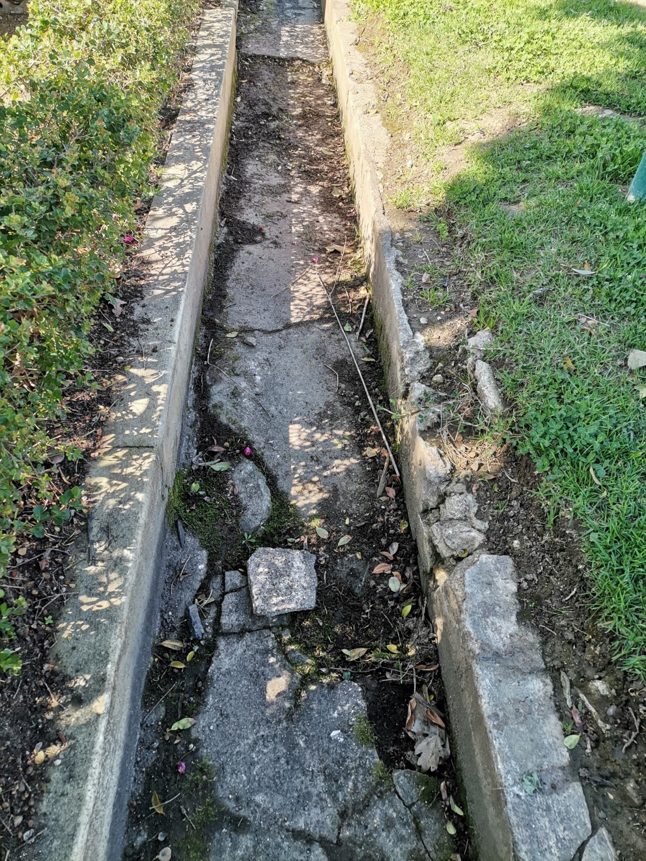
Stanford Heritage
LEIWATER
WHAT?
The Leiwater channel system was Heritage listed in 2019
It was more extensive than the current layout and has been reduced to its current extent due to major waterworks and sewerage treatment plant development.
Water originates from a freshwater spring or Eye in the limestone hills to the south of Stanford
The Leiwater flow is excess of the domestic requirements
Do not set up your gardens, pools, ponds etc being dependent upon regular Leiwater flow.

Slide 16
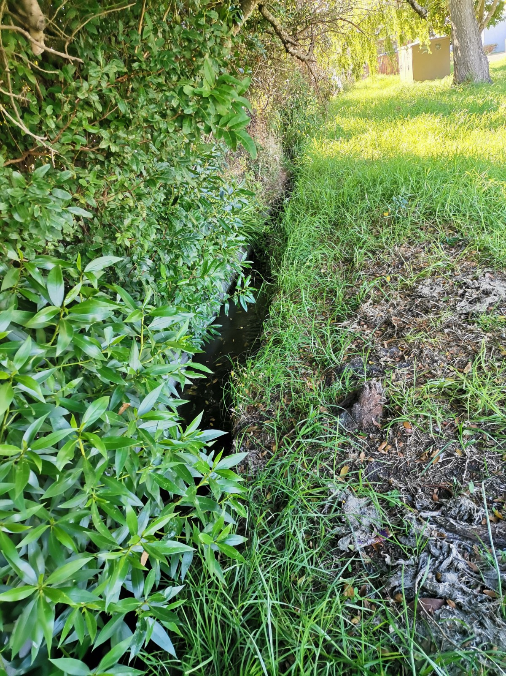
Stanford Heritage
LEIWATER
WHO?
Leiwater management team, which has been authorised by the Municipality to help manage the system
Currently comprises Karin Pohl, myself and sector leaders
We are looking for sector leaders for a few areas
Streets bounded by Shortmarket/Church/Caledon & Morton - Sector 2;
Lower Shortmarket/Adderley & Quick - Sectors 10, 11, 12.

Slide 17
Stanford Heritage
LEIWATER
HOW?
What’s been happening in the last 12 months?
Continue to formalise the system with new and active Sector leaders to implement the flow schedules
Assessing applications from new users; who must have “Water Rights on Title” plus have ready access to the Leiwater channel.
Regular communication with the Municipality, e.g. flagging and negotiating maintenance issues, blockages and clearances.
Consulting with Heritage Committee regarding the repair to damaged channels
Servicing lockable sluices, weekly changes to main sluices
Providing information and feedback to residents, builders, landscapers and irrigation installers, plus Real Estate agents.
Ensuring all channels are clear and free of vegetation, debris and litter. Clearing blockages.
Managing flooding and blockages especially during big rain events as the channels also carry stormwater runoff. Able to use the last anticipated rainfall event when we worked with Muni staff as a ‘Blue Print’ to ensure unimpeded flow away from properties.
Prepared a Leiwater channel map and description to be included in the handout to new property owners which is now distributed by Real Estate agents, along with the flood and heritage zones.

Slide 18
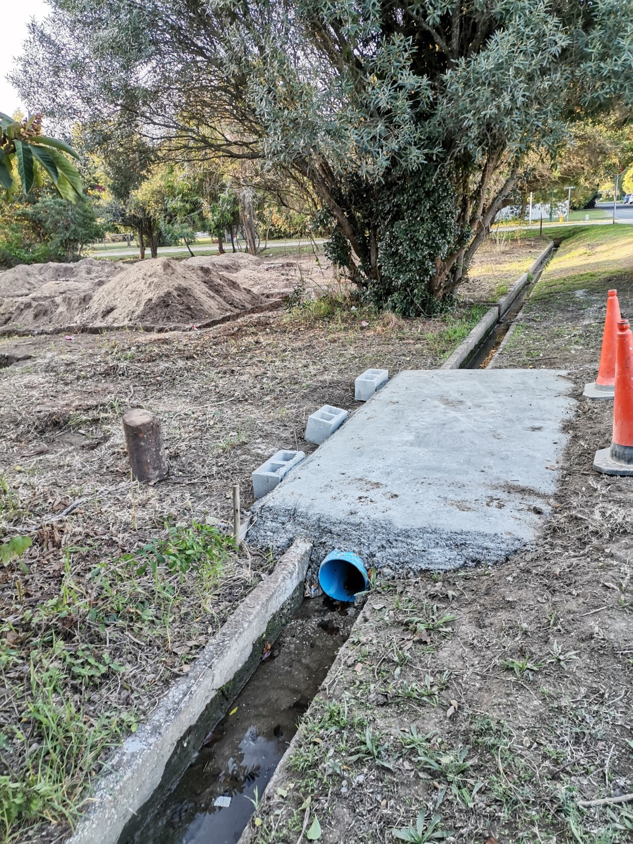
Stanford Heritage
LEIWATER
The next 12 months:
All the above plus:
A draft “Information and Management Guidelines” has been prepared and will be available on the SCT Heritage website.
All 12 sectors to have engaged and active Sector Leaders, to share the management roles.
All properties which currently harvest water will be charged for the Leiwater in their Rates Bill, once the lists have been finalised with Municipality. A set charge of R50+ per month. Currently approx. 65 on Muni’s list and over 100 using.

Slide 19
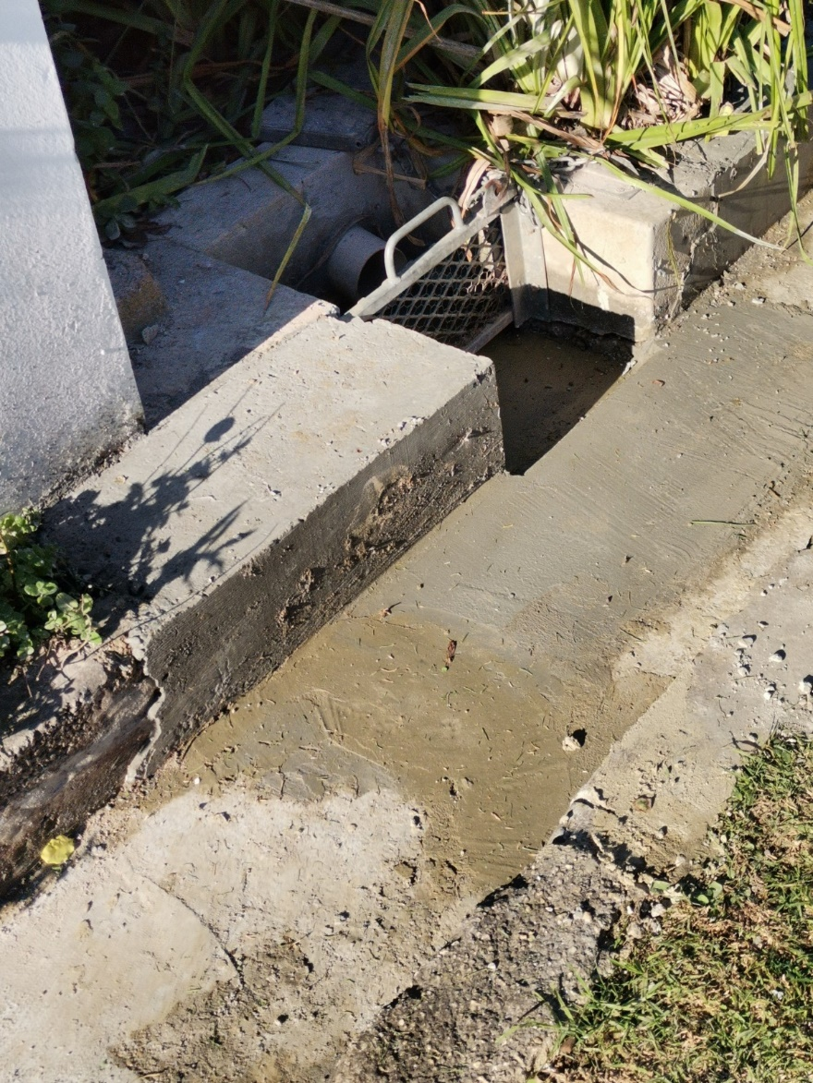
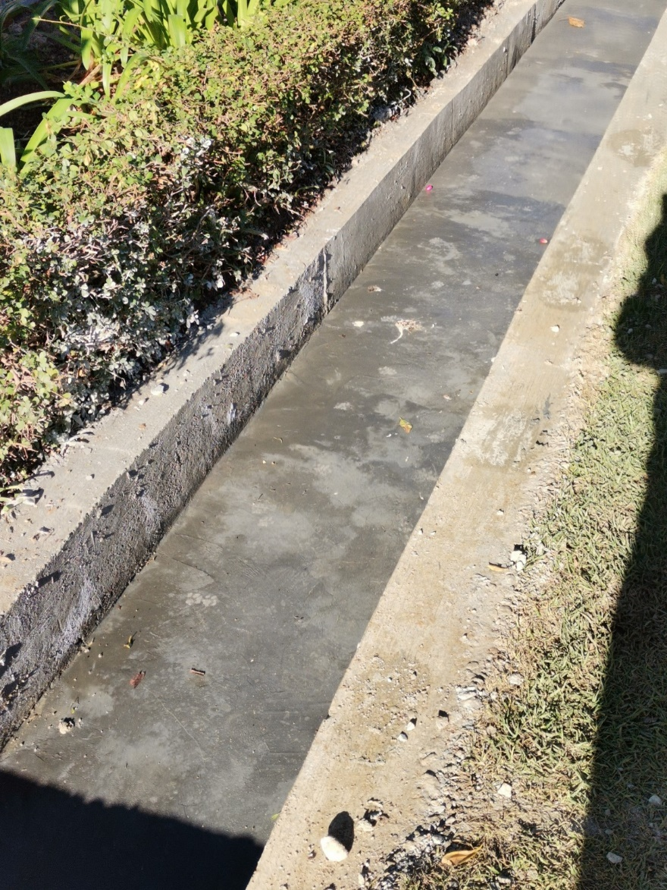
Stanford Heritage
LEIWATER
Sector Leaders:
Sector 1: Andrew Wilson
Sectors 2A & 2B: Currently vacant
Sector 3: Karin Pohl
Sector 4: Elzane Steynburg
Sector 5: Felix Unite
Sector 6: Peter Esterhuizen
Sector 7: Leigh Wolfaardt
Sectors 8 & 9: Ros Nale
Sectors 10, 11, & 12: Vacant

Slide 20
SHC Looking Forward…
As from May, the Stanford Heritage Committee will be led by James Aling.

Slide 21
Heritage Committee Report
James Aling – New Chairperson

Slide 22
Stanford Heritage
FOCUS FOR THE YEAR AHEAD
Revisit the committee modus operandi and tighten it up into a Committee Charter addressing the Committee mandate, core purpose and functions, plan review process and heritage evaluation criteria.
Improving the efficiency of service to applicants and the image of the committee in terms of confirming and meeting expectations on delivery and interaction with applicants.
Improving our relationships with Overstrand Heritage and Aesthetics Committee (OHAC), Heritage Western Cape (HWC) and the Overstrand Municipality.

Slide 23
St Thomas Church Project
Keith Brown

Slide 24
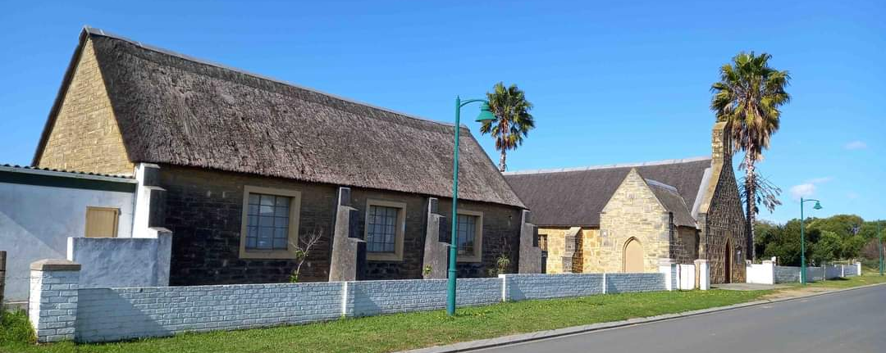
St Thomas Church Project
A BRIEF BACKGROUND
The St Thomas Anglican Church was built starting in 1863 and is the only Grade II building (of Provincial significance) in Stanford.
Originally the church building housed the first school, which was divided by a curtain strung across the church nave. It has been in continuous service for worship: during the Group Areas era the congregation refused to be stopped from worshipping there.

Slide 25
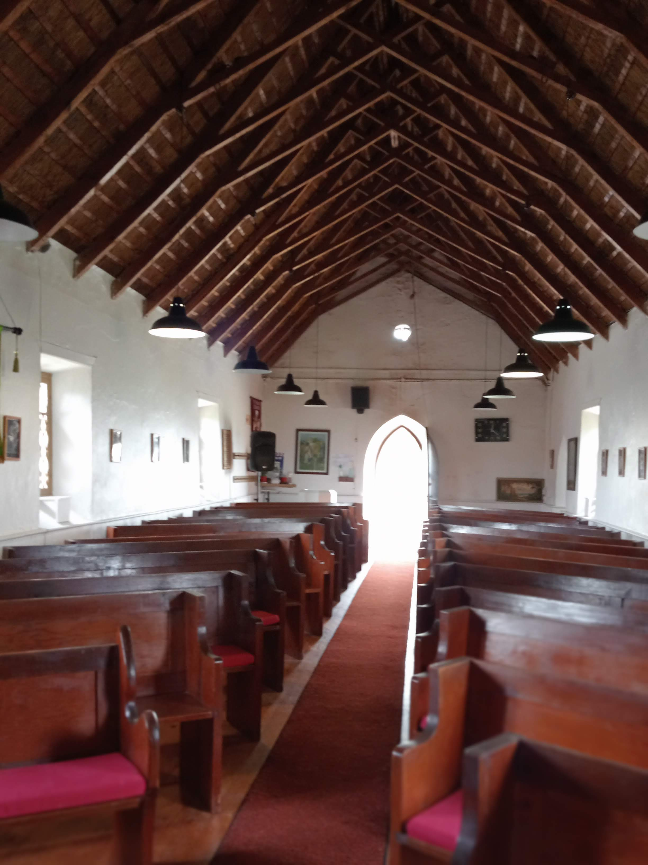
St Thomas Church Project
RAISING FUNDS
Following an intensive fundraising drive early last year, which yielded R400 000, by April re-thatching of the hall and church was nearly complete.
Attention turned to the renovation of the hall (Oulapskool): the design of the kitchenette area was finalized, and the work was completed.
As an extra, the electrical system had to be replaced, at a cost of R45,000 because it was found to be unsafe. Approval of plans by the False Bay Diocese took longer than expected. However, the results of this work are here for all to see.

Slide 26
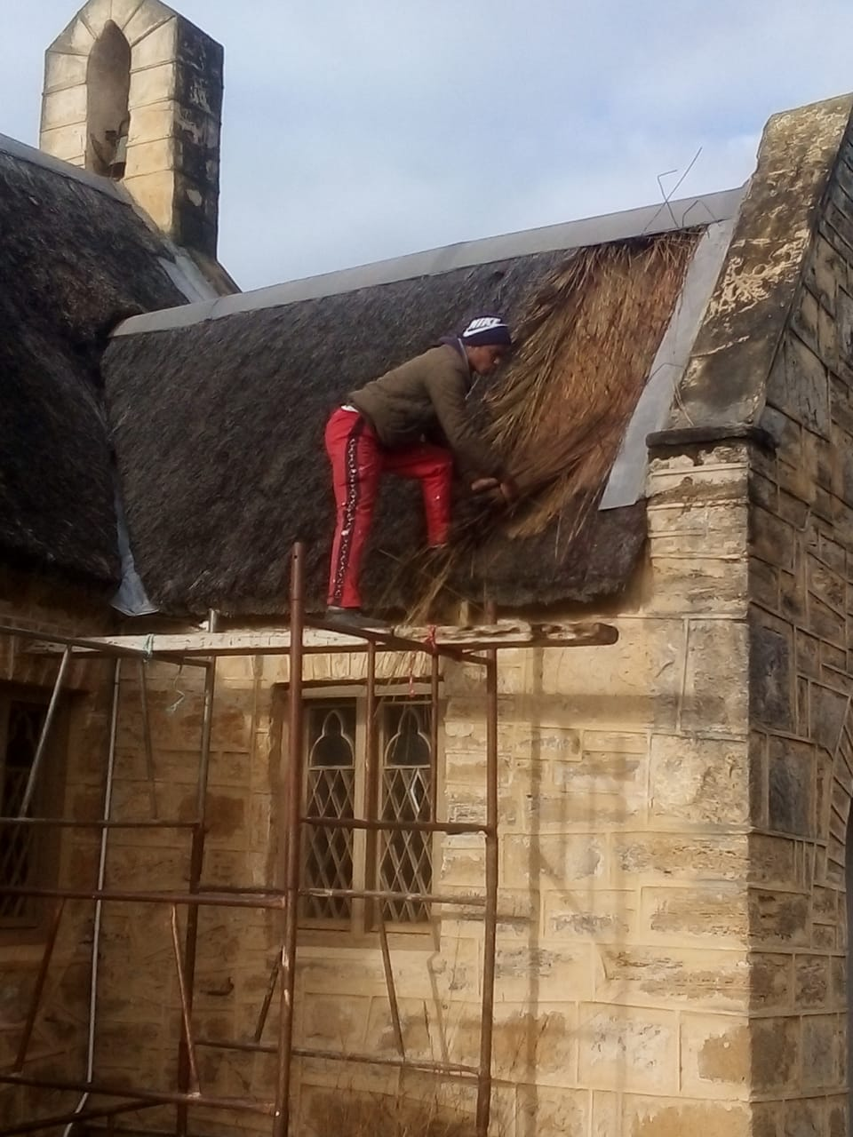
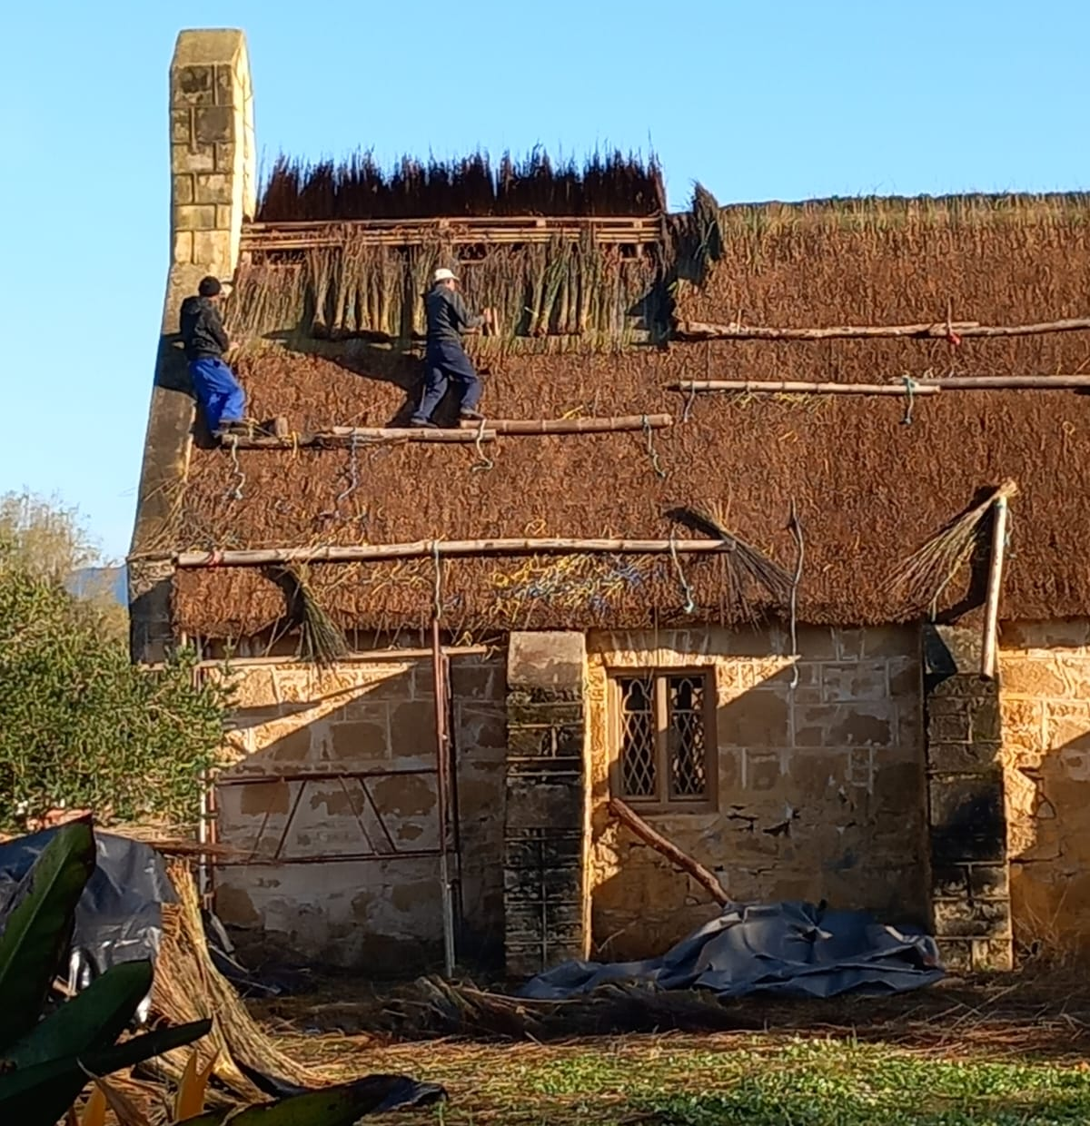
St Thomas Project
A GRANT RECEIVED
The committee succeeded in obtaining a grant from the Owen and Leta Hill Trust to repair the stonework of the church.
The first step in the project is finalizing the mortar mix to be used, to match the stonework, and this is currently in progress.

Slide 27
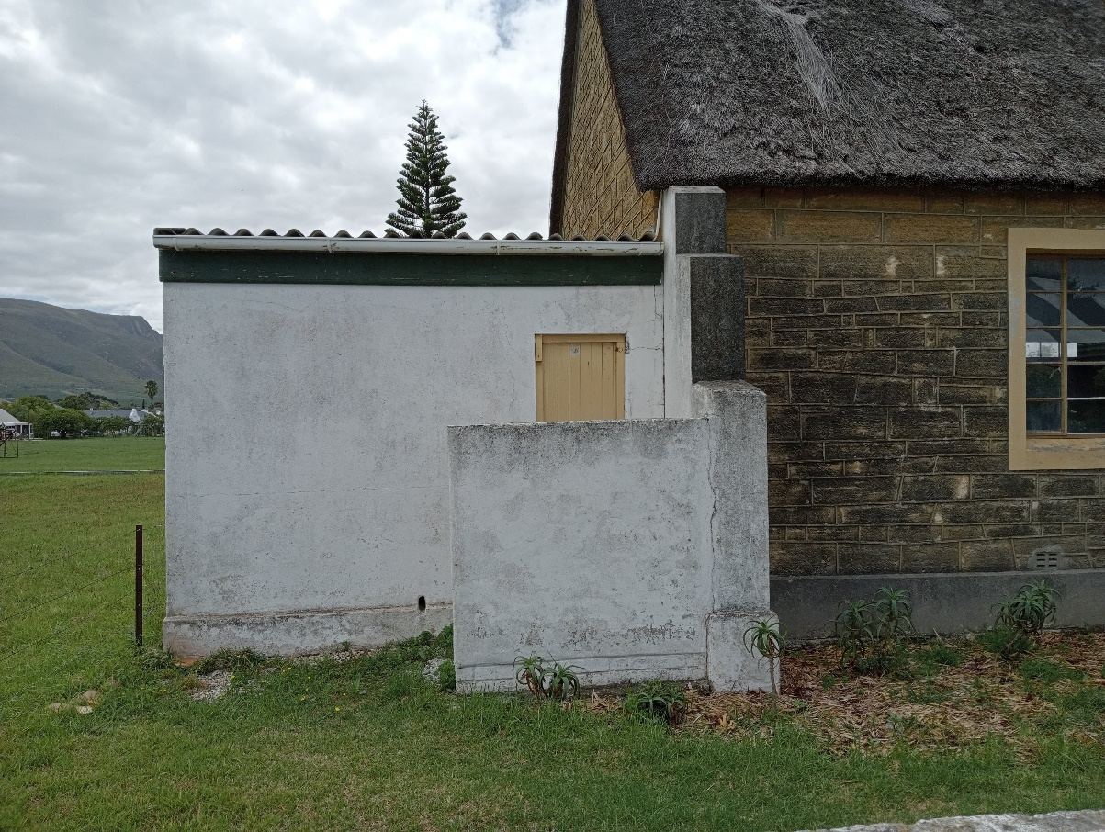
St Thomas Project
RAISING FUNDS
The steering committee, led by Stanford Conservation, comprises Henry Gibson and Hannes Appel, also Minette (Bell) and Mike Munnik, Paul and Loraine Bewsher, and Marie Minnaar, and the committee is very grateful for their willing and professional services.
The master plan for the precinct was completed and the fundraising prospectus finalized. The plan has been favourably received by, the Diocesan Trust Board.
In addition, conceptual designs have been done for the wall of remembrance and the ablution block. These have been budgeted at R110 000 and R550 000 respectively. These are the first elements in the total project which is budgeted at R1,5 million in addition to funds already spent.

Slide 28
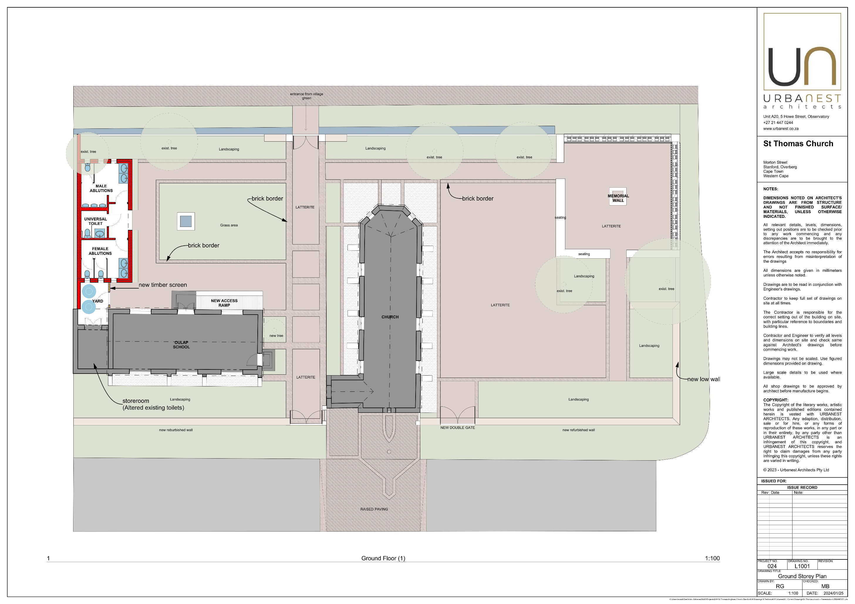
St Thomas Church Project

Slide 29
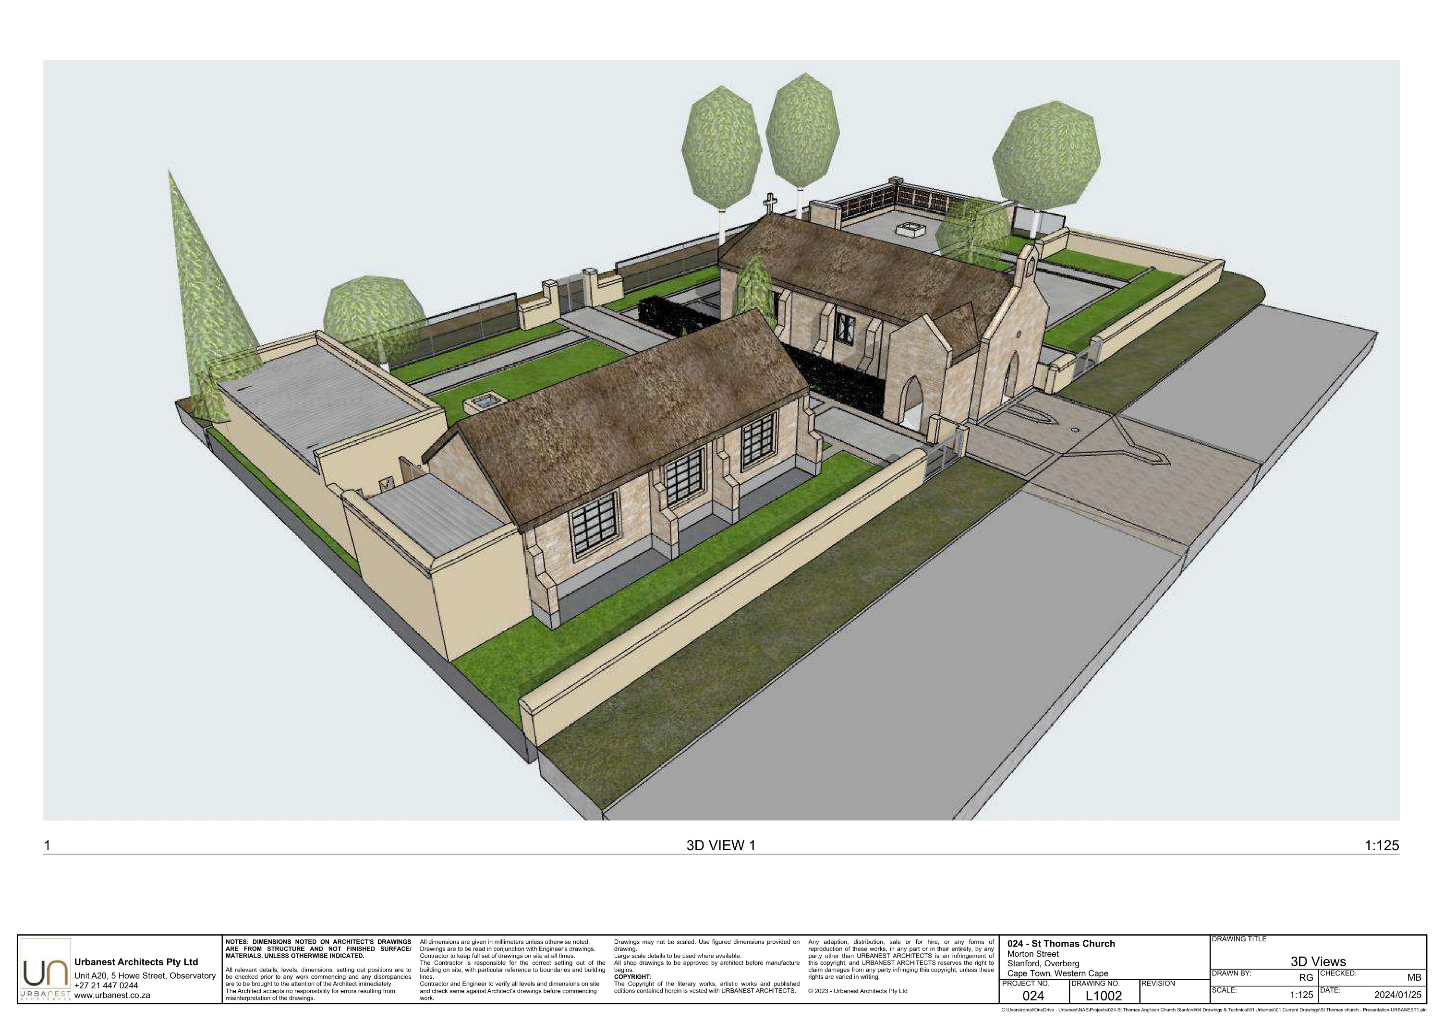
St Thomas Church Project

Slide 30
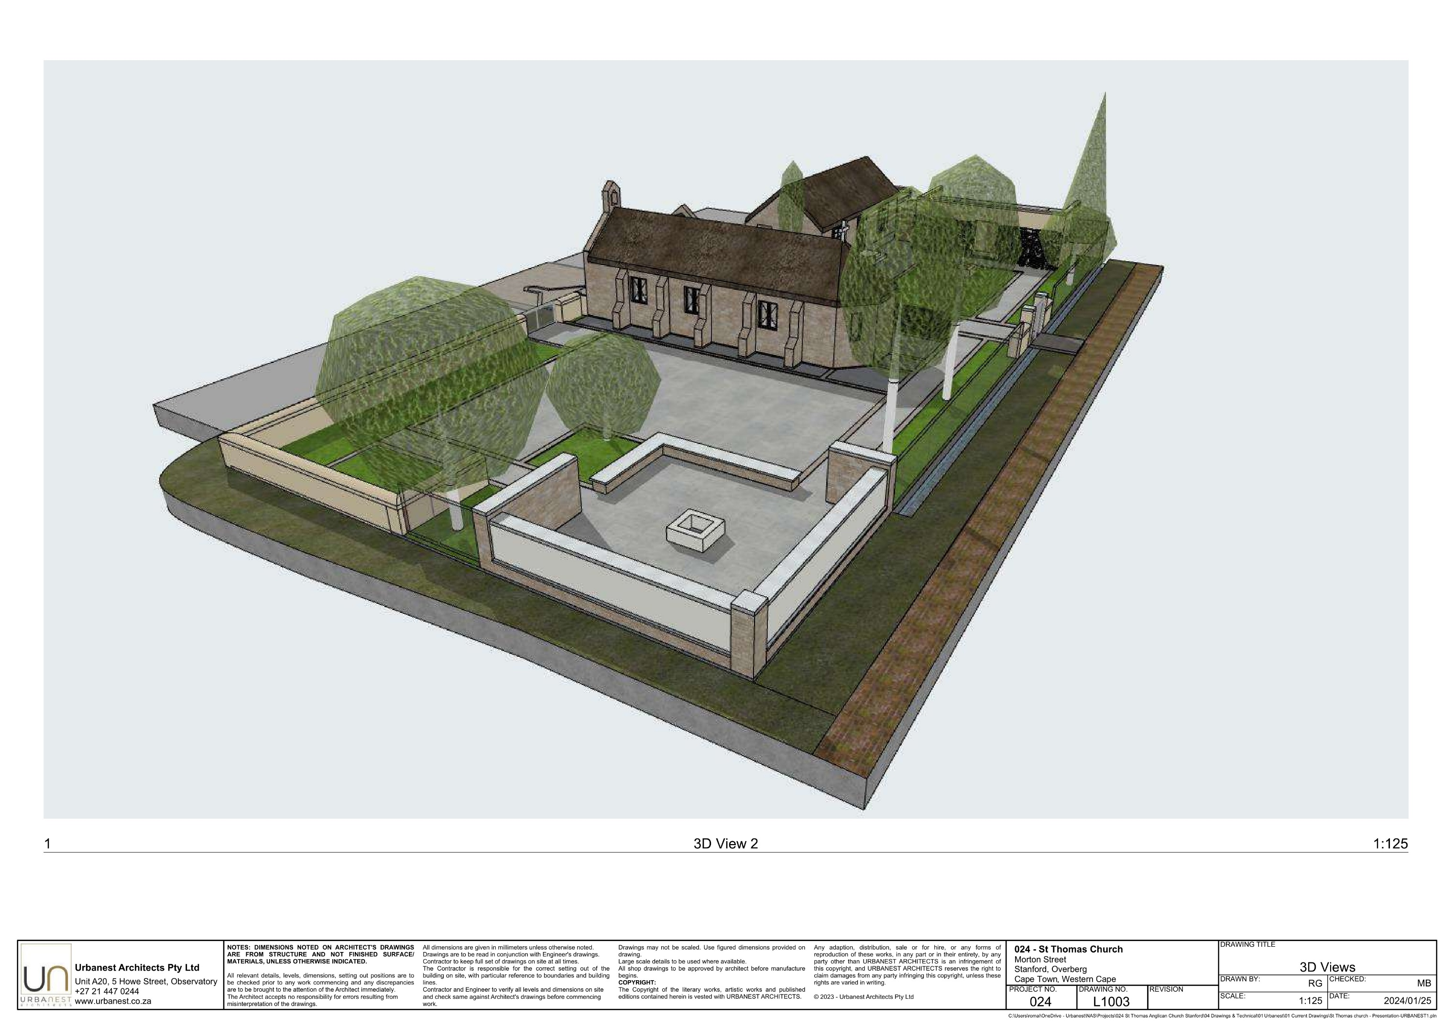
St Thomas Church Project

Slide 31
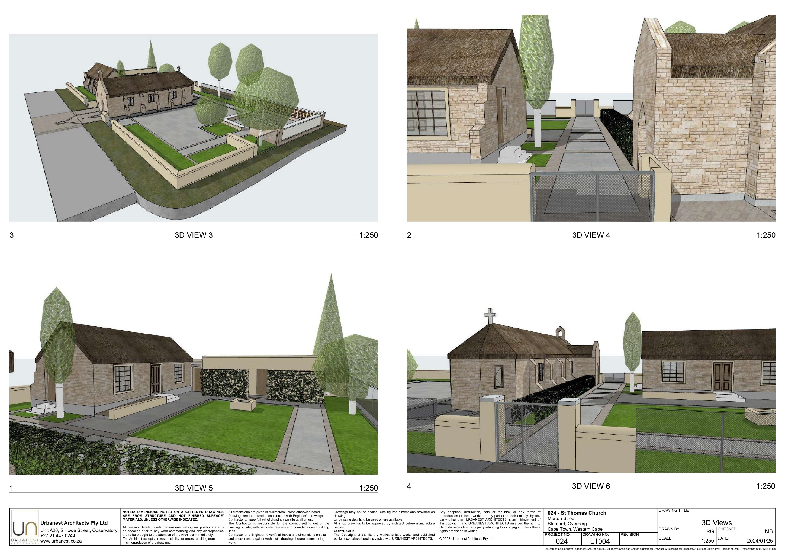
St Thomas Church Project

Slide 32
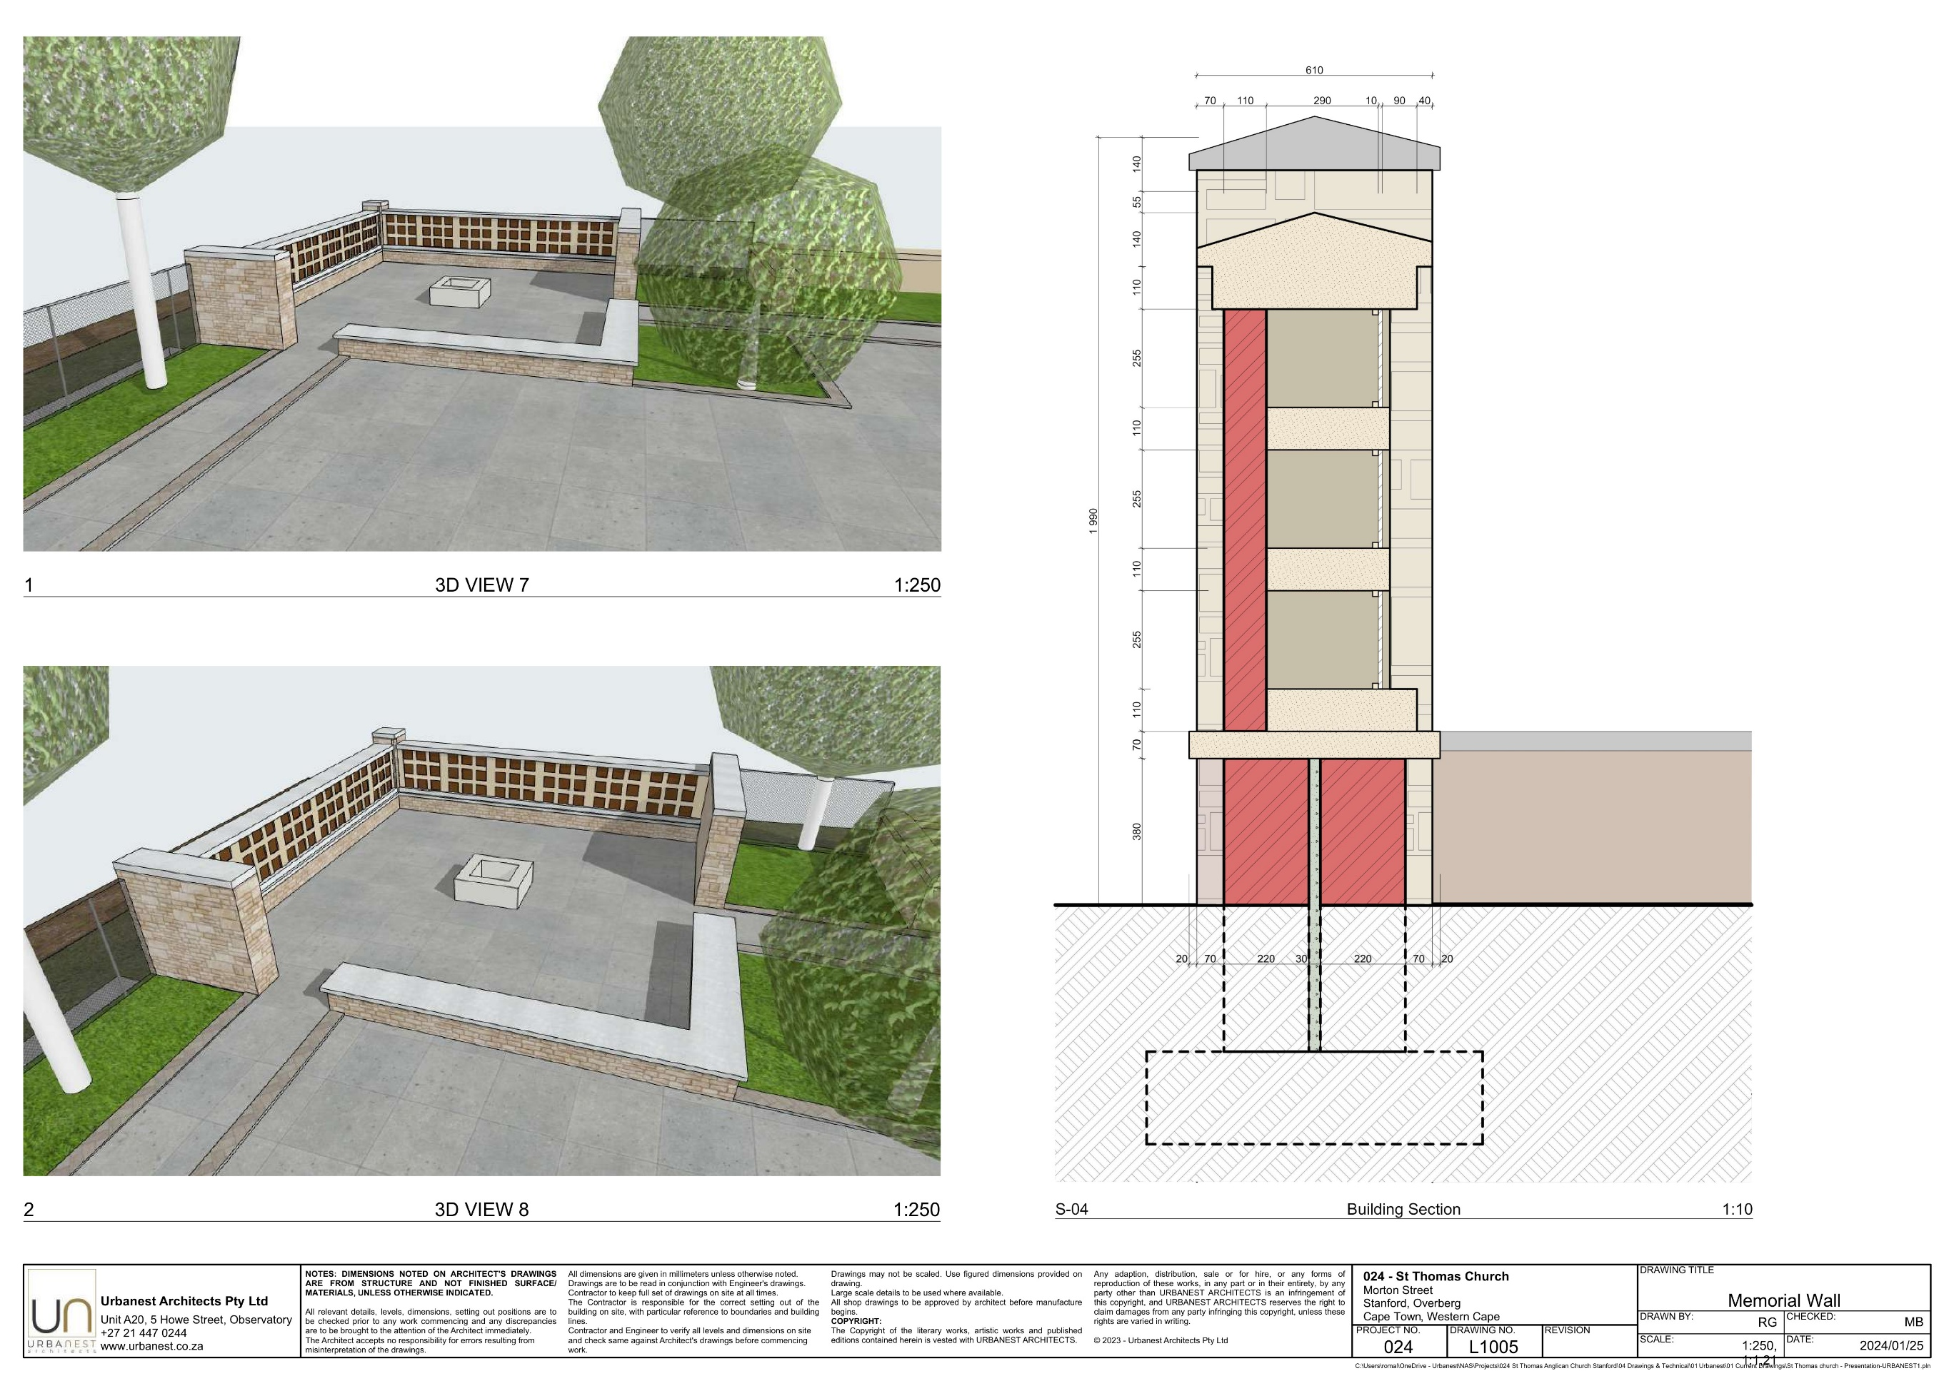
St Thomas Church Project

Slide 33
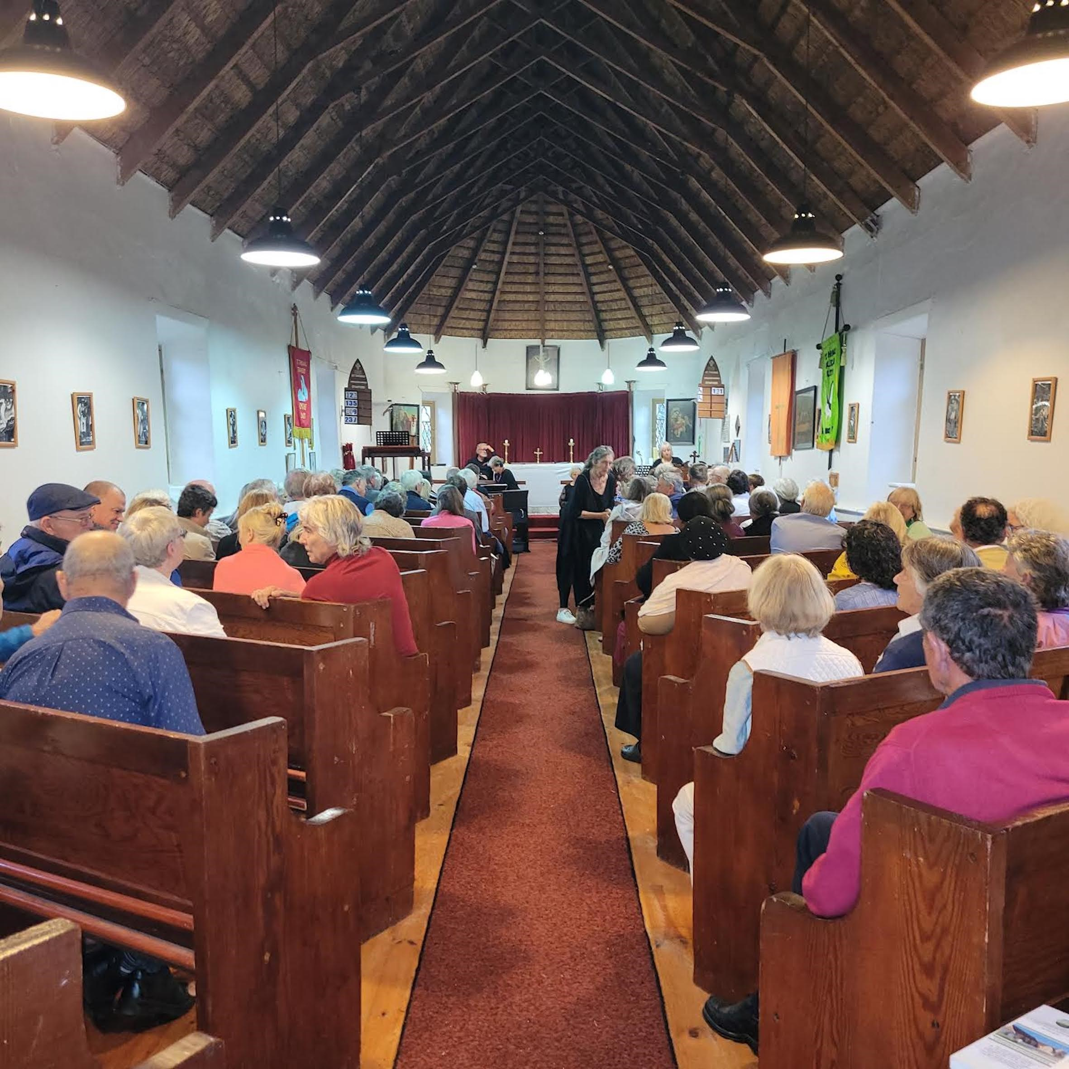
St Thomas Project
GOING FORWARD
The vision has been created to breathe new life into our village’s prime heritage site.
Significant and concentrated fundraising efforts will be necessary to bring it to fruition.

Slide 34
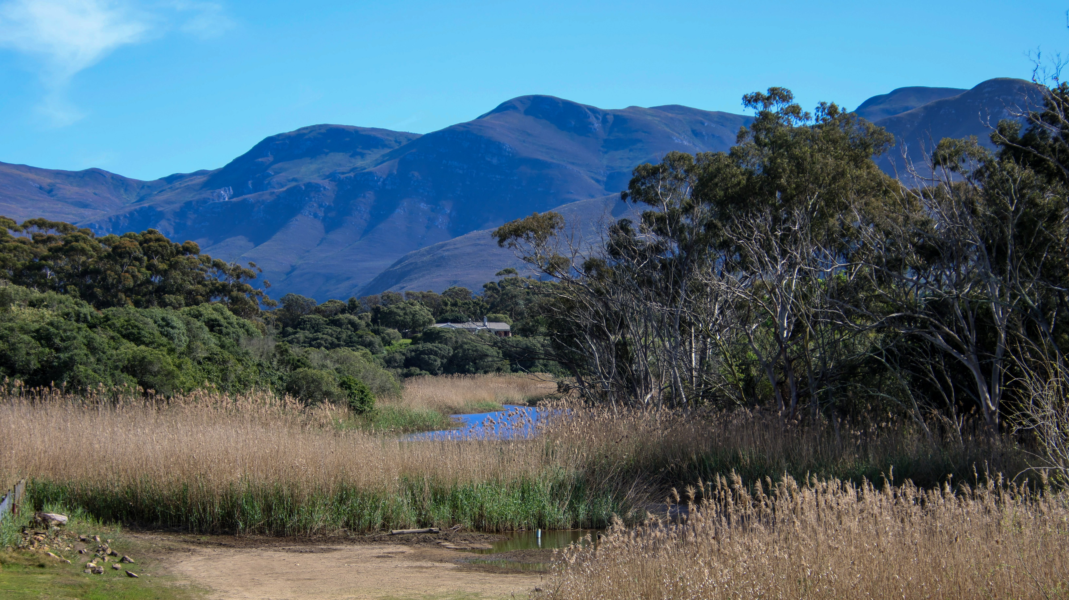
Wandelpad & Ward 1 Report
Dave Hagen

Slide 35
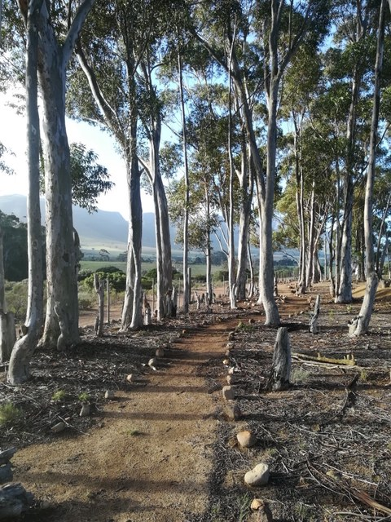
The Wandelpad
Stanford Municipality
Charl Cornelius
(Principle Administrative Officer)
Cameron “Cammy” Damon
(Cammy’s Team of Muni Workers)
Ward 1
Councilor Dudley Coetzee
Once-off Reed Cutting Funds
IDP Items for Stanford Conservation

Slide 36
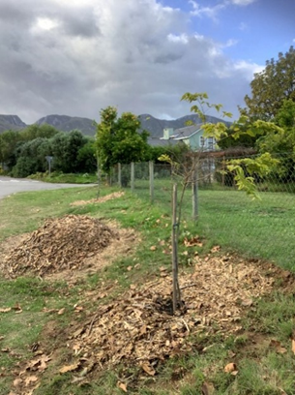
The Wandelpad
TEAM MEMBERS
Village Volunteers:
Neil Eberhardt
Bea Whittaker
Marlene Kruger
Richard Hamilton
Casper Bester
Allen Cockfield
Richard Bath
Di Parker
Dave Hagen
Debbie Braunlich
Stepped Down:
Butch Zeederberg
Neil McKenzie (Honorary Member)
Debbie Alexander
Co-Opted Members:
Tony Richardson
Marian Binder-Williams
Hard Workers:
Ernest Chikomo & Patrick Banda

Slide 37
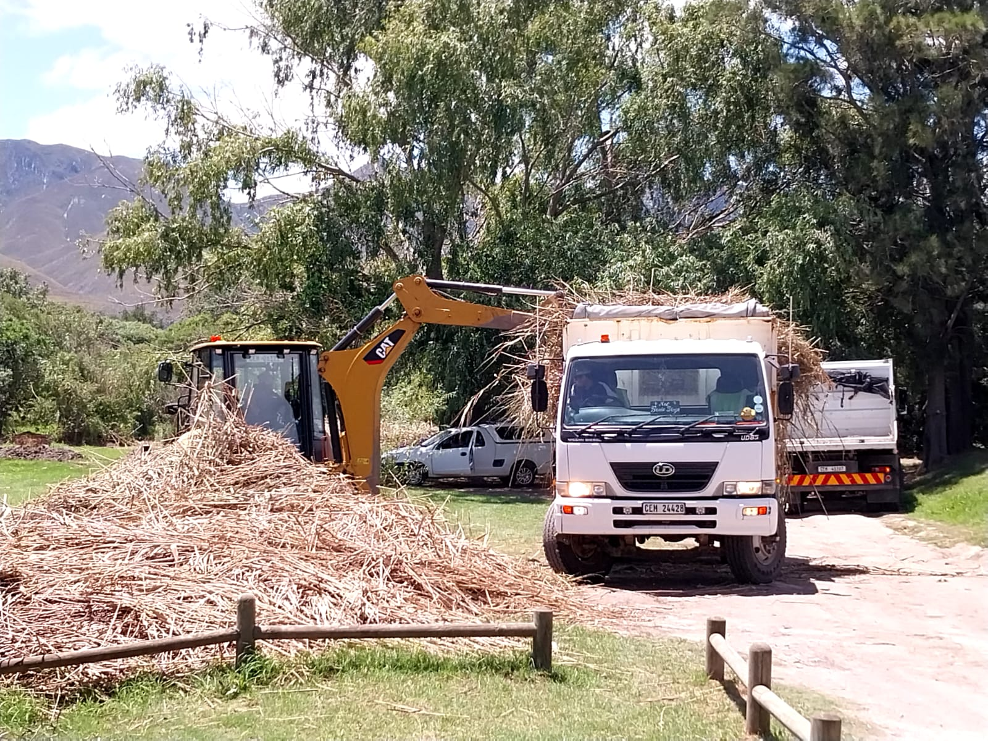
The Wandelpad
OPERATIONAL SUPPORT
Stanford Municipality:
Charl Cornelius (Village Administrative Officer)
Cameron “Cammy” Damon
Ward 1:
Councilor Dudley Coetzee
Reed Cutting Funds
IDP Items for Stanford Conservation

Slide 38
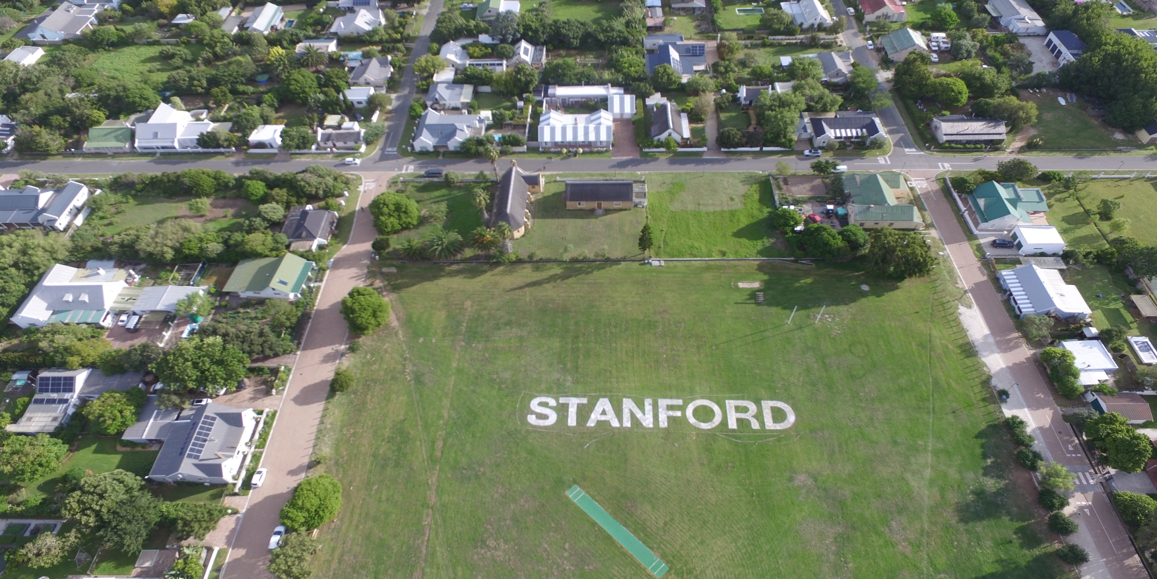
The Wandelpad
ABSA CAPE EPIC
Village was on show internationally.
Promoted as a Heritage village.
Stanford “1857”.
47-Steps, marking routes, clean up prior and afterwards.

Slide 39
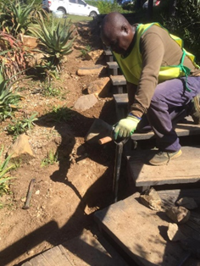
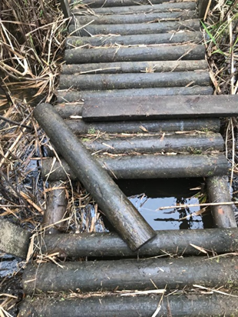
The Wandelpad
MAINTENANCE
Weeding, raking and general tidy-up.
Cleaning bins.
Cutting back reeds.
Invasive removal.
Litter and graffiti.
Irrigation.
And lots of nagging…!

Slide 40
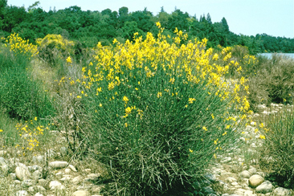
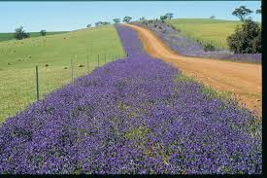
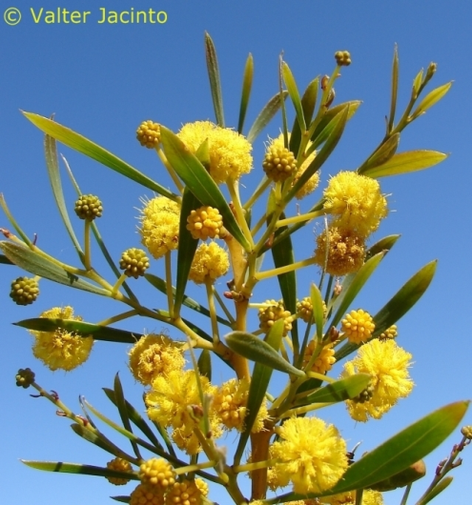
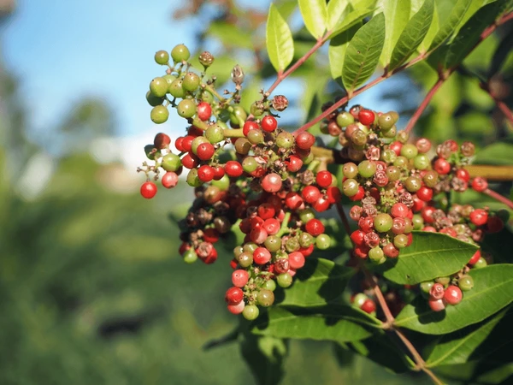
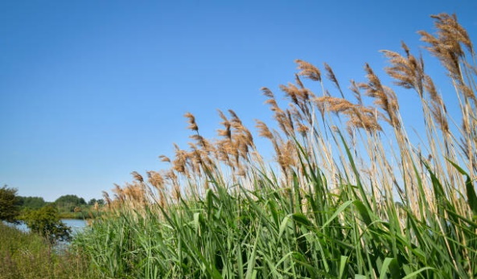
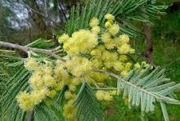
The Wandelpad
INVASIVE REMOVAL
Port Jacksons
Spanish Broom
Black Wattle
Syringa
Patterson's Curse
Poplars / Blue Gum
“Klim Op” Vine
Brazilian Pepper

Slide 41
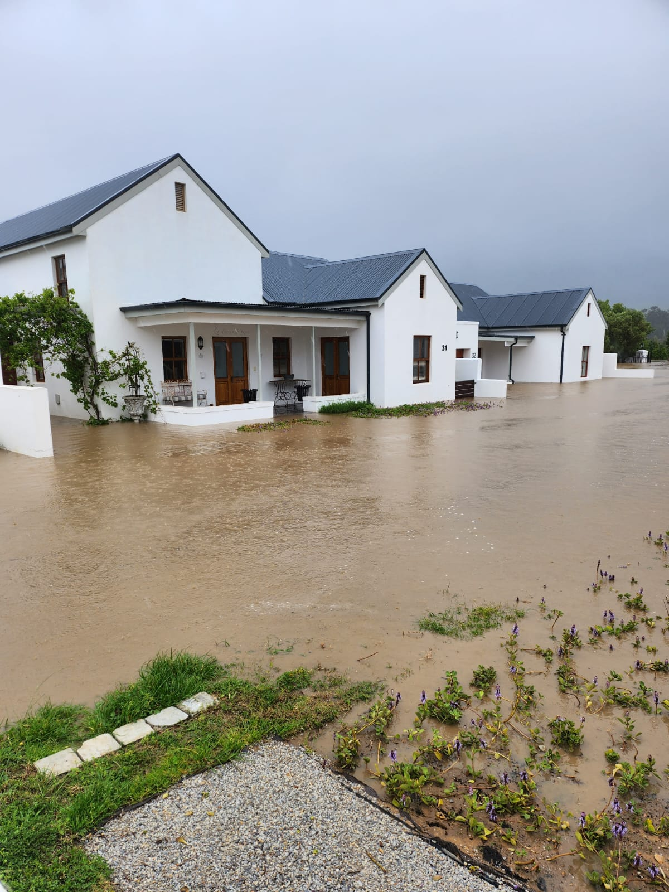
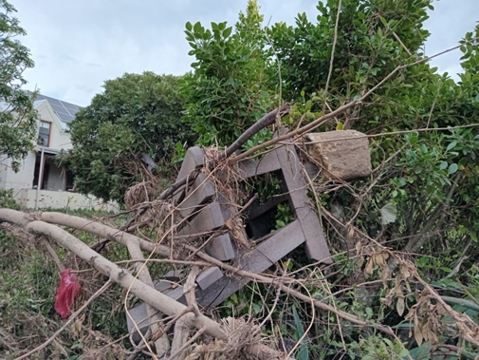
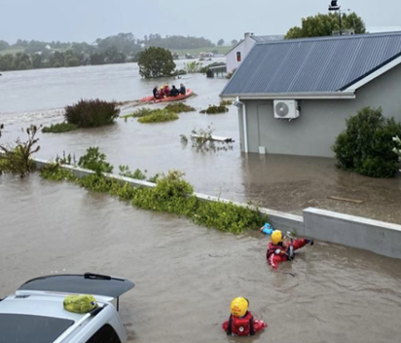
The Wandelpad
SEPTEMBER FLOOD
More than half of the Wandelpad was destroyed.
6 Wandelpad members’ homes flooded.

Slide 42
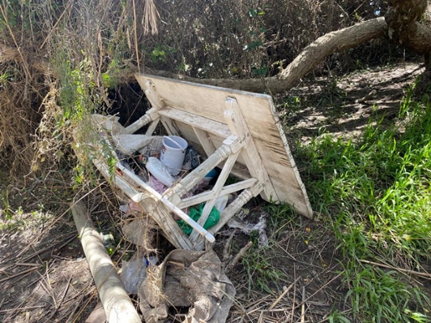
The Wandelpad
FLOOD DAMAGE FIX UP
Special thanks to Bea for managing the flood buddies.
Debbie B for taking over the reins on the Wandelpad.
Neil E helped tirelessly to fix the Wandelpad and organize the volunteer groups.
Over 45 trees and shrubs lifted, replanted and staked.
Benches/signs salvaged and new ones installed.
Memorial park to R43 – village volunteers cleared the area and collected rocks to make new paths.
Quentin Green for the land art installation.
Local farmers came to help with machinery.
Canoe club cleaned the river of litter.

Slide 43
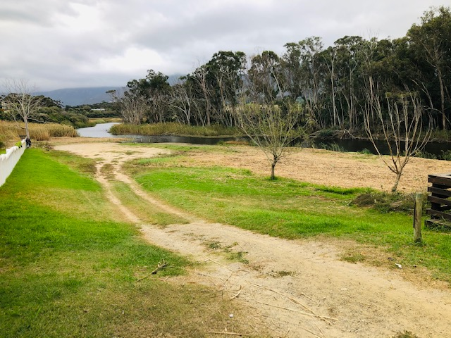
The Wandelpad
REED CLEARING PROJECT
Phragmites reed and rhizome root structure has a high impact on flood levels.
Sub-project initiated by Kevin King & Bea.
Working under the auspices of Stanford Conservation.
Crowd funded (R 26 000).
Ward 1 small project allocation of R 40 000 to cut reeds.
Scope – cut and maintain our riverside from Greer to R43 bridge
(17 000 m²).
Pilot – Kikuyu and Buffalo grass – smother/kill of rhizome
Phase 2 – Sillery to R43 – more crowd funding required.

Slide 44
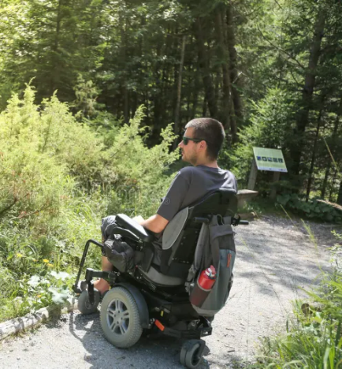
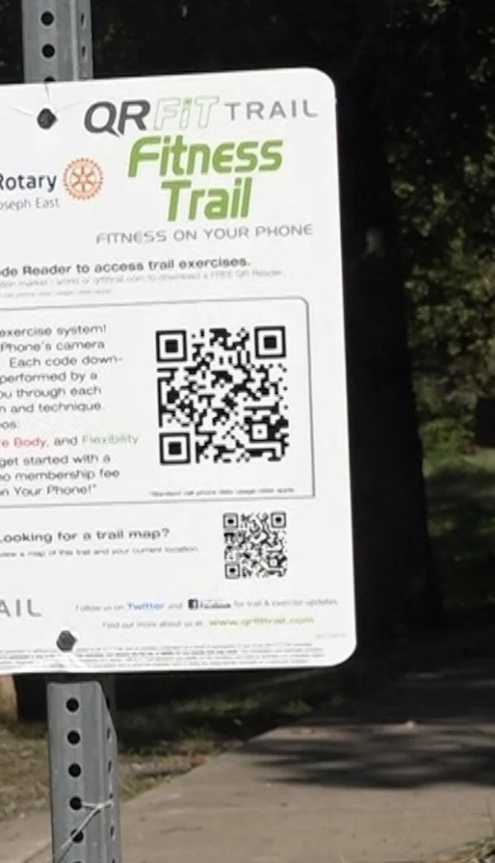
The Wandelpad
NEW INITIATIVES
Sections of Wandelpad will be wheelchair-friendly
New QR-coded signage and visitors map
- Interesting heritage information
- Donate to Stanford Conservation
- Where am I?
- Latest estuary water tests
Co-management agreement between SCT and Overstand Muni
- Safe and Healthy environment
- Protection of ecosystems
- Manage public open spaces

Slide 45
The Wandelpad
MORE INITIATIVES
Refuse bins and poo bins.
Apply and establish Urban Conservancy.
Planned natural play park at Memorial Park.
Investigating large powered cutting machine.

Slide 46
Ward 1
STANFORD CONSERVATION
Stanford Conservation - Elected on Ward 1
Strategic goals of the Overstand:
- Provision and maintenance of municipal services
- Structured community participation
- Create and maintain a safe and healthy environment
- Promote tourism, economic and social development
IDP – compiled for a 5-year period (2022-2027).
Strategic plan – planning document per ward.

Slide 47
Wandelpad & Ward 1
CLOSING & THANK YOU
Strive for a vision of the best nature trail in the Western Cape!
All who contribute time, advice and funds to conservation and the Wandelpad – thank you!

Slide 48
Swop Shop
Judi Brown for Linda Strydom

Slide 49
Swop Shop
ABOUT THE PROJECT
The SCORE Swop Shop project was started by Elma Hunter in 2014 and was adopted by Stanford Conservation in 2017 as part of its primary outreach programme.
The Swop Shop is a community-based social empowerment project with the aim of raising environmental awareness, cleaning up litter, and providing the community with some basic needs.
The shop runs from a converted container near the Community Centre.

Slide 50
Swop Shop
THE PAST YEAR
We had another busy and productive year, despite the challenges of adverse weather and difficult customers!
All in all, the Swop Shop ran smoothly, resulting in the cleanup of truckloads of recyclables, while at the same time supplying clothing, household goods, school stationery and toiletries with dignity to those who need it most.

Slide 51
Swop Shop
CHALLENGES & LOOKING AHEAD
Apart from the overwhelming attendance of children at the first two sessions in January, we noticed a big drop during the rest of the year.
We hope to resolve this by trialing morning sessions in the holidays just before the start of each term so that all school children can attend the Swop Shop.

Slide 52
Swop Shop
FUNDING
Stanford Conservation provides most of the funding to the Swop Shop, mainly funded by the Think & Drink quiz night initiative.
In addition, the steady income from the Junktique market funds toiletries and donations of pet food into ‘our’ trolley at Agri providing food to hungry pets.
The community also contributed generously towards the school bag project, providing many children with a sturdy school bag, lunch box and stationery.

Slide 53
Swop Shop
THANKS TO OUR VOLUNTEERS!
We are truly grateful to the team of 17 volunteers who diligently make themselves available every month to keep the Swop Shop doors open, despite the challenges we regularly face, be it adverse weather conditions or difficult customers!
We believe that through the project our villages are appreciating that recyclable waste has value.
We are deeply grateful to all these generous people for their amazing and continuing donations.

Slide 54
Swop Shop
FUNDING
During this new year, we would like to obtain meaningful stats on just how much recyclables are collected and how much “money” (in the form of tokens), is actually spent on a Swop Shop day.
We are truly grateful to our team of 17 volunteers who diligently make themselves available each month to keep the Swop Shop doors open.
We believe that through the project, our community members are appreciating of the fact that recyclable waste has value.

Slide 55
Forgotten Ones
Debbie Braunlich

Slide 56
Forgotten Ones
VISION & OBJECTIVES
The vision is to improve the visibility of the two historic sites and to restore them to accessible and contemplative sites for families whose loved ones are in their final resting place.
The historic and interesting nature of some of the graves adds to the depth of Stanford’s historic appeal for visitors.
The ultimate objective is that they become tourist destination points on the Heritage tours.

Slide 57
Forgotten Ones
OUR TEAM
14 Team members (core group – 6).
Meet once a week (6am in summer and 8am in winter).
Marlene Gracie
Chrissie Curnow (Oz)
Denise Anderson
Alison Thompson
Andrew Thompson
Liz Clarke
Anneline Ferreira
Beryl Gronland
Caretha Randall
Kat Goss
Robyn Ferguson
Ron Joubert
Melissa Mc Alpine
Debbie Braunlich

Slide 58
Forgotten Ones
WORK UNDERTAKEN
Twice monthly, the group have the help of sponsored gardeners who tackle some of the heavy work, e.g. brush-cutting or major pruning.
The two lectern plaques, which had been painted over, were cleaned and restored by Martin Johnson, our local calligraphist.
Some volunteers who aren’t physically active in the cemetery duties, work behind the scenes with fundraising projects. Other volunteers focus on researching data. Other volunteers assist with social media and publicity.
BEFORE
AFTER

Slide 59
Forgotten Ones
RESEARCH & RECORDING
Compilation of records and data is important for not only our municipal records but also to foster local community involvement and to complement Stanford historic interest.
Thank you to Carol Brammage and Marlene Gracie who do the research and compilation of data.

Slide 60
Forgotten Ones
NELSON MANDELA DAY
Approximately 40 people turned out to help clean up the East Cemetery.
Local restaurants sponsored a free cup of coffee to each volunteer.
We wish to thank those restaurants who participated and supported this initiative.

Slide 61
Forgotten Ones
FUTURE PROJECTS
Developing an information brochure or insert it into the Heritage booklet.
Making easily walkable paths to some of the significant gravesites.
Placing strategic QR codes at points for information about the graves.
Making seated areas for quiet reflection.

Slide 62
Treasurer’s Report
Bea Whittaker

Slide 63
Treasurer’s Report
2023/24 ACTUAL YEAR TO DATE
 | Income | Expenditure
Wandelpad | 43 306 | 54 172 | -10 866
Reed Removal | 66 000 | 26 683 | 39 317
Swop Shop | 50 430 | 71 885 | -21 455
Heritage | 18 750 | 10 410 | 8 340
St Thomas Funds | 391 806 | 434 666 | -42 860
Wall of Remembrance | 18 000 | 175 | 17 825
Admin | 58 702 | 37 693 | 21 009
 | 646 994 | 635 684 | 11 310
 |  |  | 646 994

Slide 64
Treasurer’s Report
Budget - Wandelpad
 | Income | Expenditure | Fundraising Required
WANDELPAD
Think & Drink | 36 000 | 36 000
Wandelpad Donations | 15 000
Wandelpad Signs |  | 40 000
Wandelpad Map & QR Codes |  | 25 000
Wheelchair Acess |  | 10 000
Poo Bins (4) |  | 3 600
Tree Names |  | 2 000
Playground Sillery |  | 20 000
 | 51 000 | 136 600

Slide 65
Treasurer’s Report
Budge - Reed Removal & Forgotten Ones
REED REMOVAL
Donations 2023-24 | 39 317 | 39 317
Donations 2024-25 | 25 000 | 25 000
 | 64 317 | 64 317
FORGOTTEN ONES
Maintenance Cemetries | 3 300
Brochure |  | 10 000
 | 3 300 | 10 000
Income
Expenditure

Slide 66
Treasurer’s Report
Budget – Swop Shop, Heritage & Planning
Income
Expenditure
SWOP SHOP
Piggy bank | 21 650 | 20 000
Stationery | 6 000 | 50 000
Junktique (Toiletries) | 35 000 | 35 000
 | 62 650 | 105 000
HERITAGE
Historical Information | 9 750 | 10 000
 | 9 750 | 10 000
PLANNING GROUP
Stanford Signage Guideline |  |  | 125 000
 | 0

Slide 67
Treasurer’s Report
Budget – St Thomas Church
ST THOMAS FUNDS
Existing Restoration Work | 112 380 | 112 380
Ablution Block |  |  | 600 000
Boundary Walls & Hard Landscaping |  |  | 800 000
 | 112 380 | 112 380

Slide 68
Treasurer’s Report
Budget - Administration
ADMIN
Interest Received | 5 000
Membership Fees | 50 000
Bank Charges |  | 1 000
ManCo Meetings |  | 1 000
AGM & Member Meetings |  | 3 000
Gifts |  | 1 000
Liability Insurance |  | 3 840
Repairs & Maintenance |  | 7 000
Audit Fees |  | 4 500
 | 55 000 | 21 340

Slide 69
Treasurer’s Report
Marketing & Communications
MARKETING:
Web Hosting |  | 3 600
Website Development |  | 3 400
Branding Materials |  | 8 000
 |  | 15 000
TOTALS | 376 222 | 492 462 | 1 657 175
SURPLUS FROM 2023-24 | 132 212 | 15 972 | SURPLUS FOR 2024-25
 | 508 434 | 508 434

Slide 70
Other Business?
Election of Management Committee
John Kelley (Chairperson)
Bea Whittaker (Treasurer)
Melissa Mc Alpine (Secretary)
James Aling (Heritage)
Dave Hagen (Wandelpad & Ward 1)
Linda Strydom (Swop Shop)
Debbie Braunlich (Forgotten Ones)
Keith Brown (St Thomas Church)

Slide 71
In Closing
So to our members…
Does SCT add value to our village?
Are you comfortable with how the SCT is managing our portfolios?
Now let’s talk about coffee again…
2024 Fees
2025 Fees

Slide 72
THANK YOU FOR SUPPORTING STANFORD CONSERVATION!
stanfordconservation1992@gmail.com
stanfordheritage@gmail.com

